Slide 1




ROI GROCERY MARKET REVIEW
Data to 9th of June 2013

Slide 2

OVERVIEW
Market Overview
The market is seeing positive growth on an annual basis (+0.2%) however it has declined in the shorter term by -0.2%.
While there has been price inflation, shoppers continue to compensate for price increases by purchasing on offer, buying less volume and trading down to cheaper lines. This has meant that household spend has declined year on year.
Irish households are spending more per trip this period, however they are making less trips and spending less per year.
Shopping around is still evident.
Private Label continues to drive growth in a number of retailers.

Slide 3
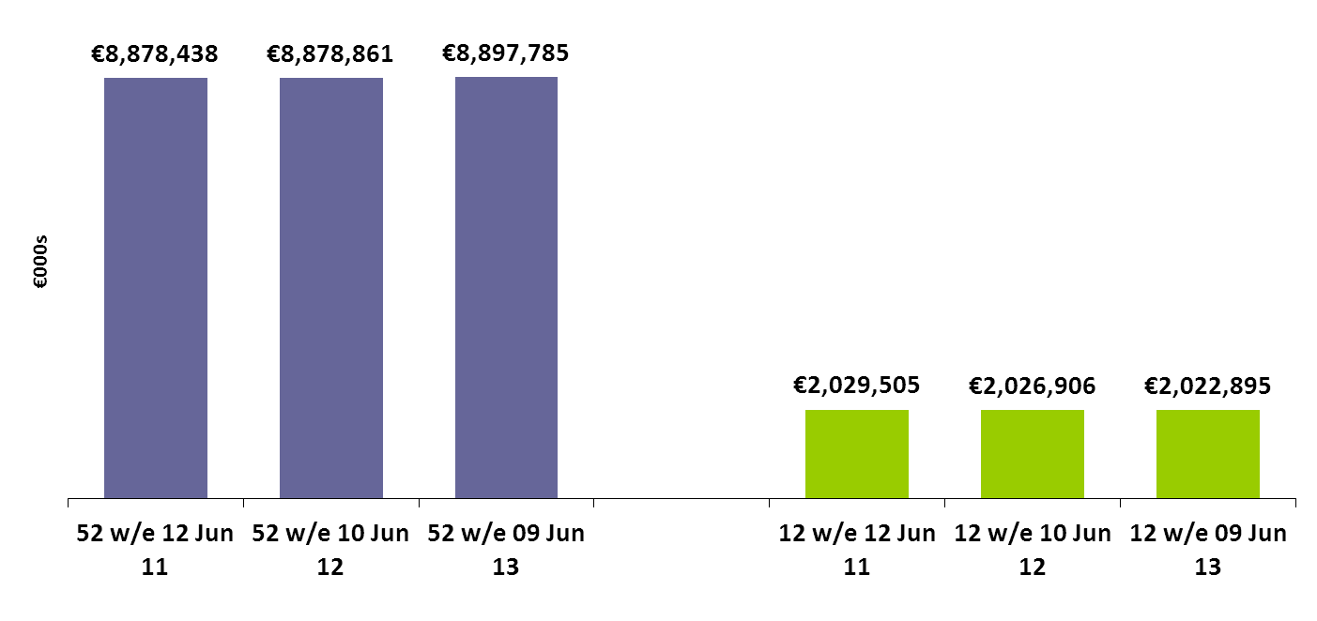
TOTAL IRISH GROCERY MARKET VALUE AND GROWTH 52 &12 W/E
The Irish grocery market is in growth over 52w period by 0.2% and however over the 12w period is in decline by -0.2%.
0%
+0.2%
-0.1%
-0.2%
3

Slide 4
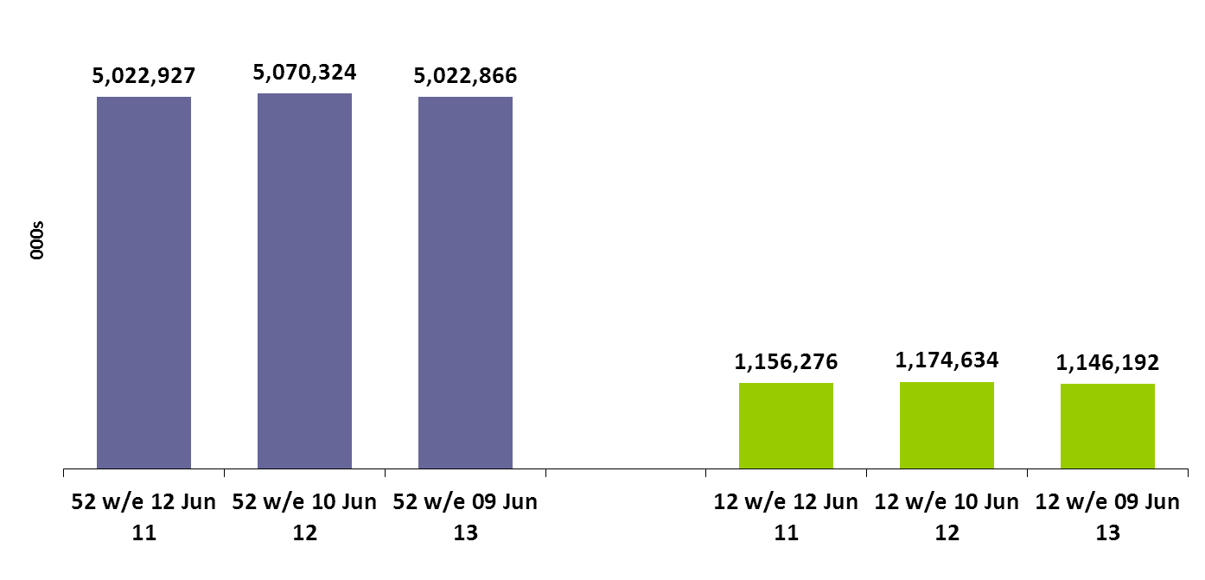
TOTAL IRISH GROCERY VOLUME SALES AND GROWTH 52 &12 W/E
Volume of sales declines as shoppers cut back on volume purchased
+0.9%
-0.9%
+1.6%
-2.4%
4

Slide 5
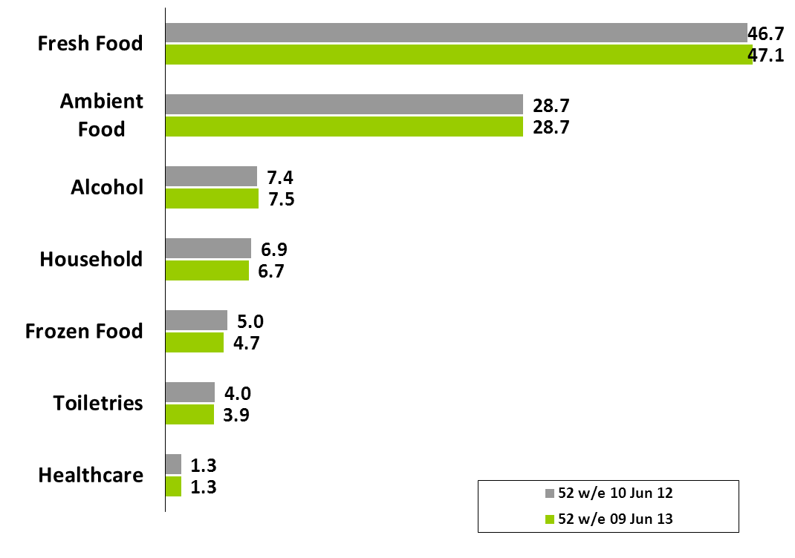
TOTAL GROCERY SECTOR VALUE SHARE & GROWTH 52W/E
Fresh Food is driving growth in the Grocery Sector on a yearly basis along with Ambient Food, Alcohol and Healthcare
+1.1%
+0.3%
+2.1%
-2.5%
-5.6%
-2.3%
+2.6%

Slide 6
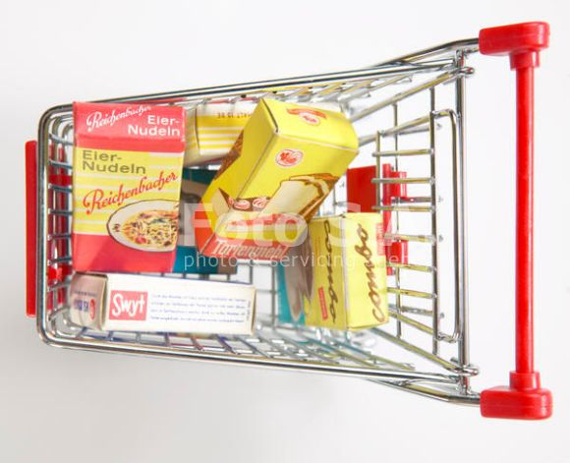
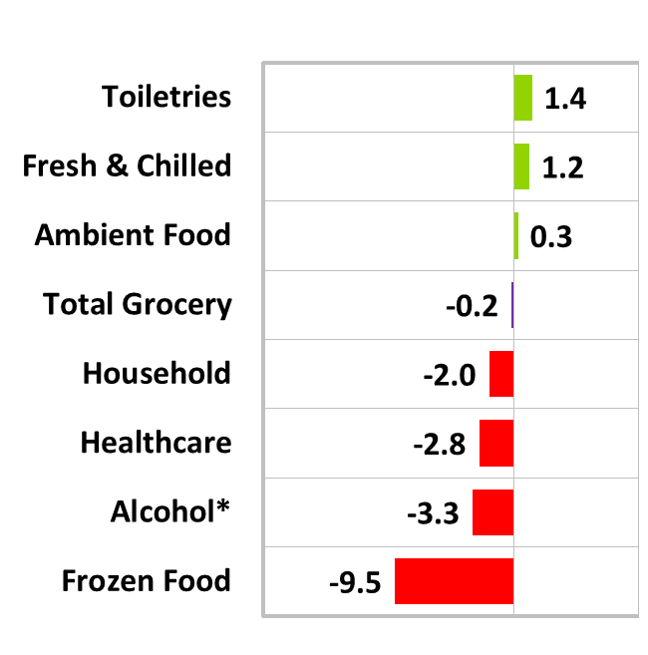
TOTAL GROCERY SECTOR VALUE SHARE & GROWTH 12W/E
Grocery Market’s decline has been driven by the performance of Frozen Food, Alcohol, Healthcare and Household
Share of total trolley
Ambient Food
29%
Fresh & Chilled Produce
48%
Household 7%
Frozen 5%
Toiletries 4%
Healthcare 1%
Alcohol 7%
Total Trolley
-0.2% value
6

Slide 7
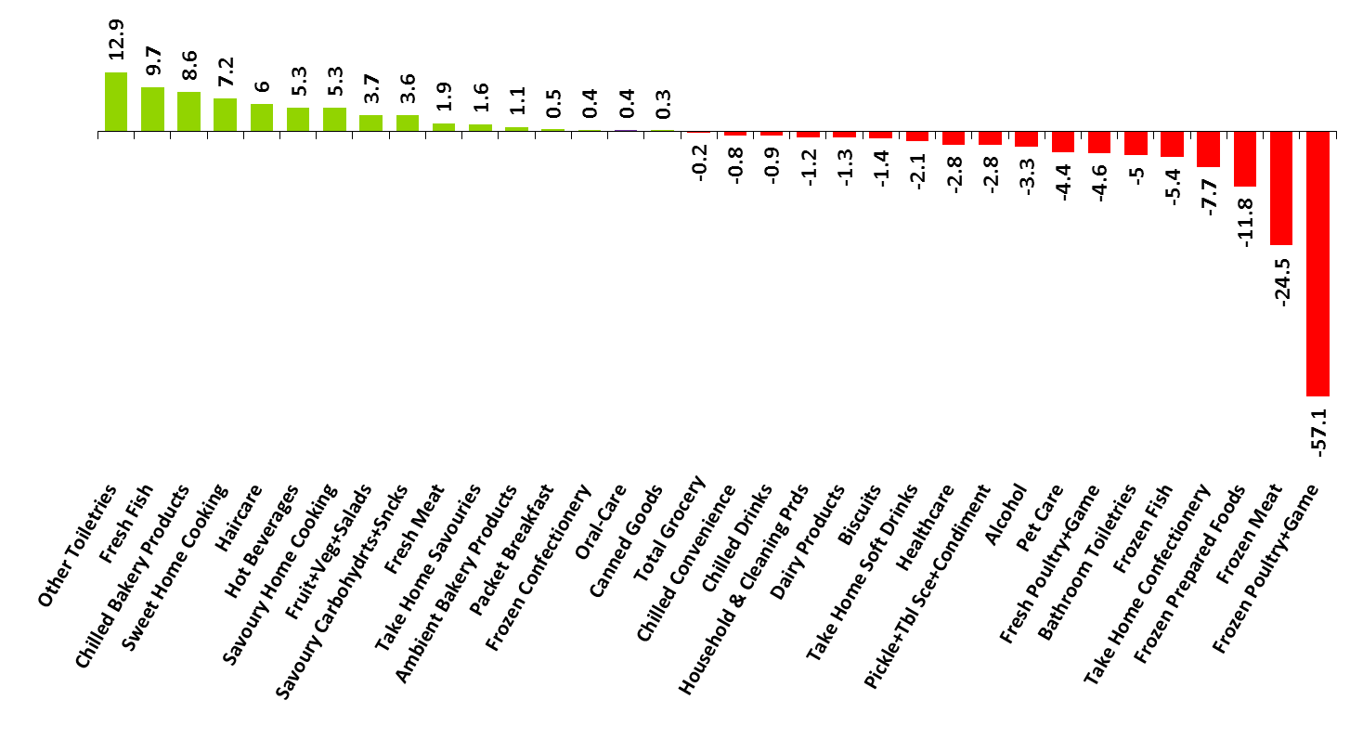
ANALYSIS BY CATEGORY - GROWTH/DECLINE?
Chilled Bakery and Fresh Fish have grown, on the back of decline for Frozen Categories
12w Total Grocery - value % chg by category
7

Slide 8
Large majority of markets seeing price inflation
Inflation by category (selection) – 12 week period
8

Slide 9
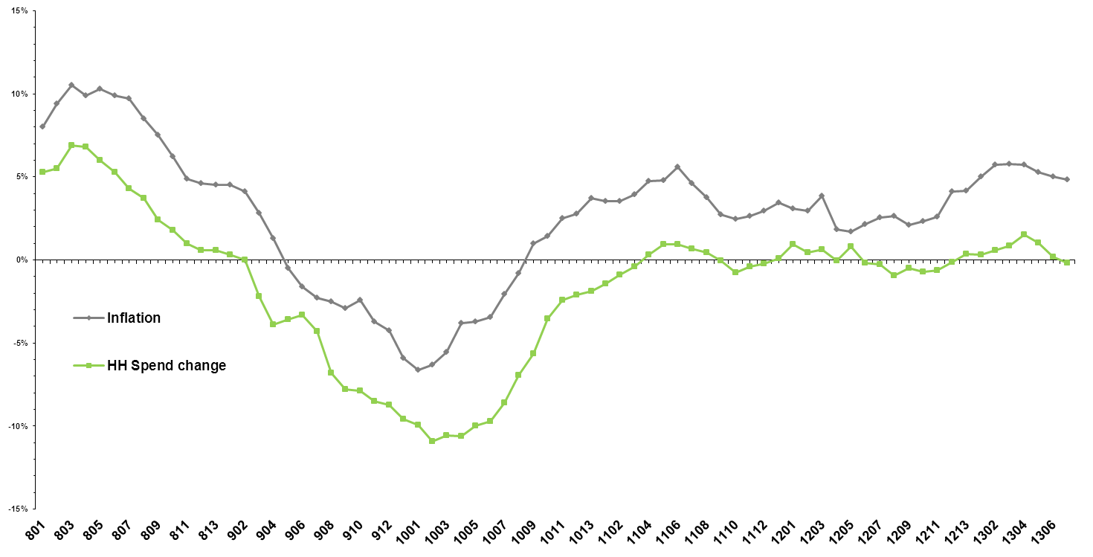
CHANGE IN INFLATION RATES AND HOUSEHOLD SPEND 12 W/E
As inflation rises, Household spend remains flat as consumers battle rising inflation by looking for options to spend less
% change year on year – 12 week period
9

Slide 10
TRENDED VIEW OF CONSUMER COPING STRATEGIES -12 W/E
Shoppers continue to counteract price inflation by trading down, buying less volume and buying on promotion
10

Slide 11
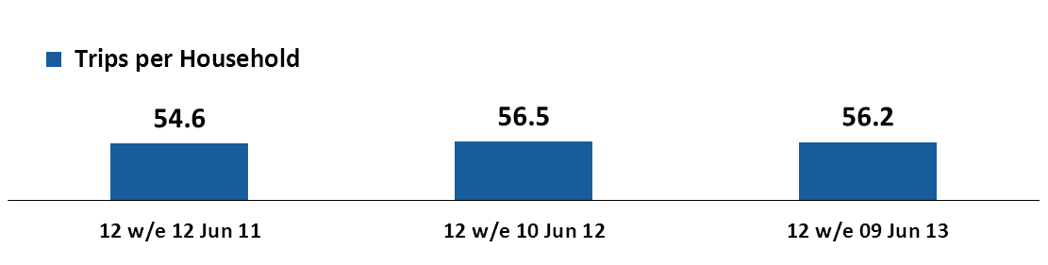
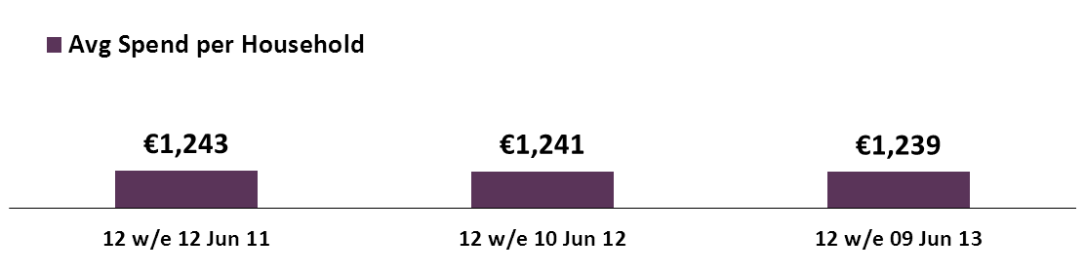
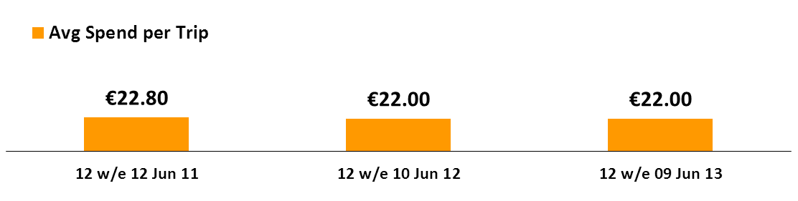
CHANGES IN CONSUMER SHOPPING BEHAVIOUR 12 W/E
Frequency has decreased by -0.4%, as Households spend less on shopping, down €2
12w Total Grocery - changes in consumer shopping behaviour
Average frequency decreased by
-0.4%
Decrease in 12w spend per HH
(-0.2%)
Average basket spend is up by
+0.3%
11

Slide 12
NUMBER OF STORES ON AVERAGE VISITED
Consumer are now visiting more stores on average
2007 = 2.5 Stores
2013 = 3.0 Stores

Slide 13
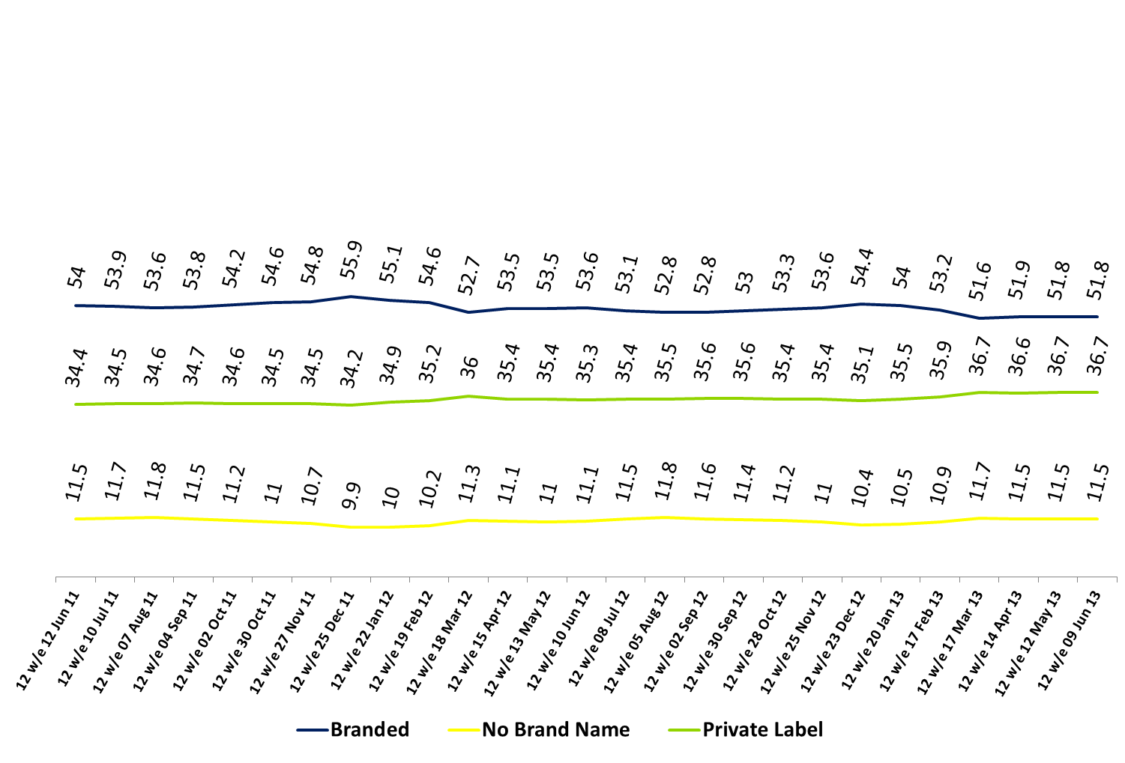
SHARE of MARKET – BRANDED, PRIVATE LABEL and NO BRAND NAME
Private Label sales continue to grow with Branded share dropping closer to 50%
12w Total Grocery – PL value%
13

Slide 14
PRIVATE LABEL VALUE SHARE OF TOTAL IRISH GROCERY
Private Label sales continue to grow - now making up over 36% of the market
12w Total Grocery – PL value%
14

Slide 15
PRIVATE LABEL % VALUE SHARE BY CATEGORY
Where is Private Label Strong? – Meats and staples are key for Private Label
12w Total Grocery – Categories where Private Label Overtrade
15

Slide 16
PRIVATE LABEL % VALUE SHARE BY CATEGORY
Where is Private Label weaker? – Categories with multiple strong brands and toiletries
12w Total Grocery – Categories where Private Label Undertrade
16

Slide 17
MARKET SHARE AND GROWTH BY BRANDED AND PRIVATE LABEL TIER
Standard PL in growth this period while Premium PL declines
% Value share
% Value growth

Slide 18
TOTAL GROCERY - % PACKS SOLD ON DEAL – 52 W/E Shoppers perceive the % packs sold on deal is consistent over time

Slide 19
TOTAL GROCERY - SOLD ON DEAL TRENDED 12W/E We haven’t seen much change in the proportion of sales on deal with more consistent promotional activity across retailers

Slide 20

% of branded grocery spend accounted for by round € or 50c price points
Round Pricing is a key promotional method

Slide 21
TOTAL CROSS BORDER – SHARE OF ROI GROCERY Cross Border Sales continue to decline - now making up just 2% of Sales (€182m)

Slide 22
12W TOTAL GROCERY – TOTAL CROSS BORDER VALUE% OF ROI GROCERY
Cross border share of sales grew slightly to 1.9% over the last period but still remains much behind levels in previous years. We do still see a slight peak around Christmas time
22

Slide 23
TOTAL CROSS BORDER - % PENETRATION
Shopper numbers peak over Christmas with just over 18% of ROI households Crossing the Border

Slide 24

UK GROCERY

Slide 25
TOTAL UK GROCERY – VALUE SALES UK market showing growth year on year as inflation plays a part
52w/e
+3.5%

Slide 26
UK MARKET GROWTH AND INFLATION
Inflation in the UK slightly behind Ireland but market growth is stronger

Slide 27
PRIVATE LABEL % MARKET SHARE Private label also rising in the UK and now almost 50% of spend

