Slide 1


National Consumer Agency
Market Research Findings:
Consumer Switching Behaviour
September 2013
Research Conducted by

Slide 2

Table of Contents
Key Findings
Consumer Switching Behaviour
Research Background and Methodology
Profile of Sample

Slide 3
Key Findings

Slide 4
Key Findings
When describing their consumer behaviour, 37% of consumers said they ‘tend to stick with the same company for products and services’. While 27% said they ‘change companies often and avail of better deals’.
Switching provider highest for main grocery shop (26%), car insurance (23%) and top-up grocery shop (20%), followed by electricity (16%) and gas (16%). Overall the proportion who have switched at least one product or service provider is 45%.
Majority of switchers saved money - average monthly saving resulting from switching is around €15 to €20 per sector. This tends to be higher in health insurance where the average saving reported was €42.
The research found in the sectors surveyed that a large number of consumers have not checked to see if there is a better package/deal available to them.
Perceived barriers to switching included “it may be more hassle than a benefit” and “don’t believe there is much difference between suppliers”.

Slide 5
Consumer Switching Behaviour

Slide 6
Consumers becoming more open to changing providers
Base: All Adults – 1,012
Nov 2012 | June 2013
% | %
Highest amongst:
55+ & Farmers
I tend to stick to the same companies
I generally stick with the same companies but will look around
I change companies often and avail of better deals whenever I can
Highest amongst:
35-49s, ABC1s and Dublin
Highest amongst:
25-34s
C2DE
Leinster & Conn/Uls
Loyal vs proactive switchers | +21% |  | +10
37% of consumers would describe their consumer behaviour as tending to stick with the same companies. 27% prefer to change companies often and avail of better deals whenever they can.

Slide 7
Consumer Behaviour x Demographics
Base: All Adults – 1,012
Gender
Age
Social Class
Region
Lein-ster
%
Mun-ster
%
Conn/Uls
%
Total
%
Male
%
Female
%
U 24
%
25-34
%
35-49
%
50-64
%
65+
%
ABC1
%
C2DE
%
F
%
Dublin
%
I tend to stick with the same companies for products & services
I generally stick with the same companies for products and services but will look around if I experience poor service or price increases
I change companies often and will avail of better deals/service whenever I can

Slide 8
Consumer Switching Behaviour remains reasonably high
Base: All who hold products
%
45% have switched at least 1 product or service provider in the past 12 months.
Highest incidence of switching in the last 12 months was for the main grocery shop provider (26%), followed by car insurance (23%) and top-up grocery shop (20%). Overall the proportion who have switched at least one product or service provider is 45%.

Slide 9
High proportions of people are saving money by switching
Base: All switchers in each category
SAVED MONEY WHEN SWITCHED
%
9 in 10 (89%) who switched their car insurance provider saved money. 87% saved when switching health insurance provider.

Slide 10
Consumers monthly savings from switching
Base: All switchers in each category
Saved money when switched | Average monthly savings €
Car insurance provider (145) | 13.18
Health insurance provider (30) | 42.78
Home insurance provider (68) | 9.62
Gas supply service (43) | 18.42
Fixed/ Landline telephone provider (59) | 18.38
Broadband internet access (75) | 15.02
Electricity supply service (104) | 19.09
Waste / Bin service provider (37) | 14.32
Mobile telephone provider (63) | 23.46
TV service provider e.g. Sky, UPC (25) | 23.91
Monthly savings made by switching car insurance on average were found to be €13. In the utilities sectors, on average consumers saved €19 when switching electricity provider and €18 when switching gas provider.

Slide 11
Biggest Barrier to Switching Across Products
Base: All who hold products
Difficulty in comparing products | Distrust of price offered | Switching more hassle than benefit | Don’t believe there is much difference between suppliers | I just can’t be bothered | Other | No Barrier
% | % | % | % | % | % | %
Perceived hassle and a belief there is not much of a price difference appear to be the highest barriers to switching. Price comparisons are less of an issue, highest for car insurance (15%) and health insurance (13%).

Slide 12
Biggest Barrier to Switching Across Products - 1
Base: All who hold products
Difficulty in comparing products | Distrust of price offered | Switching more hassle than benefit | Don’t believe there is much difference between suppliers | I just can’t be bothered | Other | No Barrier
% | % | % | % | % | %
Switchers V Non Switchers
Car insurance provider
Health insurance provider
Gas supply service
Fixed/Land line telephone provider
Broad-band Internet access provider
Electricity supply service

Slide 13
Biggest Barrier to Switching Across Products - 2
Base: All who hold products
Difficulty in comparing products | Distrust of price offered | Switching more hassle than benefit | Don’t believe there is much difference between suppliers | I just can’t be bothered | Other | No Barrier
% | % | % | % | % | %
Switchers V Non Switchers
Home insurance provider
Life Insurance/Mortgage Protection
Mobile telephone provider
TV Service provider e.g. Sky, UPC
Waste/Bin Service Provider

Slide 14
More recent price checking evident across full spectrum of utilities
Base: All holders of relevant services
W10 November 2012
W11 June 2013
Fixed Landline |  |  | Broadband |  |  | Mobile Phone |  |  | TV Service |  |  | Electricity Provider |  |  | Gas Provider
W10 | W11 |  | W10 | W11 |  | W10 | W11 |  | W10 | W11 |  | W10 | W11 |  | W10 | W11
% | % |  | % | % |  | % | % |  | % | % |  | % | % |  | % | %
Past 12 months
More than 12 months but less than 3 years
More than 3 years
Have never checked
Increase in shopping around for better deals since previous research. Highest incidence of shopping around in broadband providers - 36% of consumers checked within the past 12 months for a better deal or package.

Slide 15
Price checking also evident across insurance products especially Car Insurance
Base: All who hold products
Health insurance provider | Car insurance provider | Home insurance provider | Life Insurance/ Mortgage Protection | Waste/Bin service provider
% | % | % | % | %
Past 12 months
More than 12 months but less than 3 years ago
More than 3 years ago
Have never checked
*No comparable data

Slide 16
Most recent price checking - Switchers Vs Non Switchers - 1
Base: All holders of relevant products
Fixed/Land line telephone provider | Broadband Internet access provider | Mobile telephone provider | Electricity supply service | Gas supply service | TV Service provider e.g. Sky, UPC
Switched | Not Switched |  | Switched | Not Switched |  | Switched | Not Switched |  | Switched | Not Switched |  | Switched | Not Switched |  | Switched | Not Switched
% | % |  | % | % |  | % | % |  | % | % |  | % | % |  | % | %
Past 12 months
More than 12 months but less than 3 years ago
More than 3 years ago
Have never checked

Slide 17
Most recent price checking - Switchers Vs Non Switchers - 2
Base: All holders of relevant products
Car insurance provider* | Home insurance provider* | Life Insurance/ Mortgage Protection* | Waste/Bin Service Provider
Switched | Not Switched |  | Switched | Not Switched |  | Switched | Not Switched |  | Switched | Not Switched
% | % |  | % | % |  | % | % |  | % | %
Past 12 months
More than 12 months but
less than 3 years ago
More than 3 years ago
Have never checked
Switchers doing most recent checking.

Slide 18
Direct debit most common form of payment for bills - Switchers Vs Non Switchers
Base: All who hold products
Broad-band Internet access provider |  |  | Fixed/ Land line telephone provider |  |  | Electricity supply service |  |  | Gas supply service |  |  | Home insurance provider |  |  | Car insurance provider |  |  | Waste/ Bin service provider |  |  | Mobile telephone provider
Switched | Not Switched |  | Switched | Not Switched |  | Switched | Not Switched |  | Switched | Not Switched |  | Switched | Not Switched |  | Switched | Not Switched |  | Switched | Not Switched |  | Switched | Not Switched
% | % |  | % | % |  | % | % |  | % | % |  | % | % |  | % | % |  | % | % |  | % | %
Direct Debit
Cash
Electronic transfer
Cheque
Prepaid cards
Other
*Life insurance/health insurance and TV switching base too small

Slide 19
Research Background and Methodology

Slide 20
A. Research Background and Methodology
Nov/Dec 2007
Aug 2008
Nov/Dec 2008
May/June 2009
Benchmark
Wave 1
Wave 2
Wave 3
Nov/Dec 2009
June 2010
Nov/Dec 2010
May/June 2011
Wave 4
Wave 5
Wave 6
Wave 7
Nov 2011
June 2012
Nov 2012
June 2013
Wave 8
Wave 9
Wave 10
Wave 11
The research was conducted face-to-face using CAPI interviewing with 1,012 adults 16+.
To ensure that the data is nationally representative, quotas were applied on the basis of age, gender and social class.
Interviewing was conducted from 6th – 19th June 2013.

Slide 21
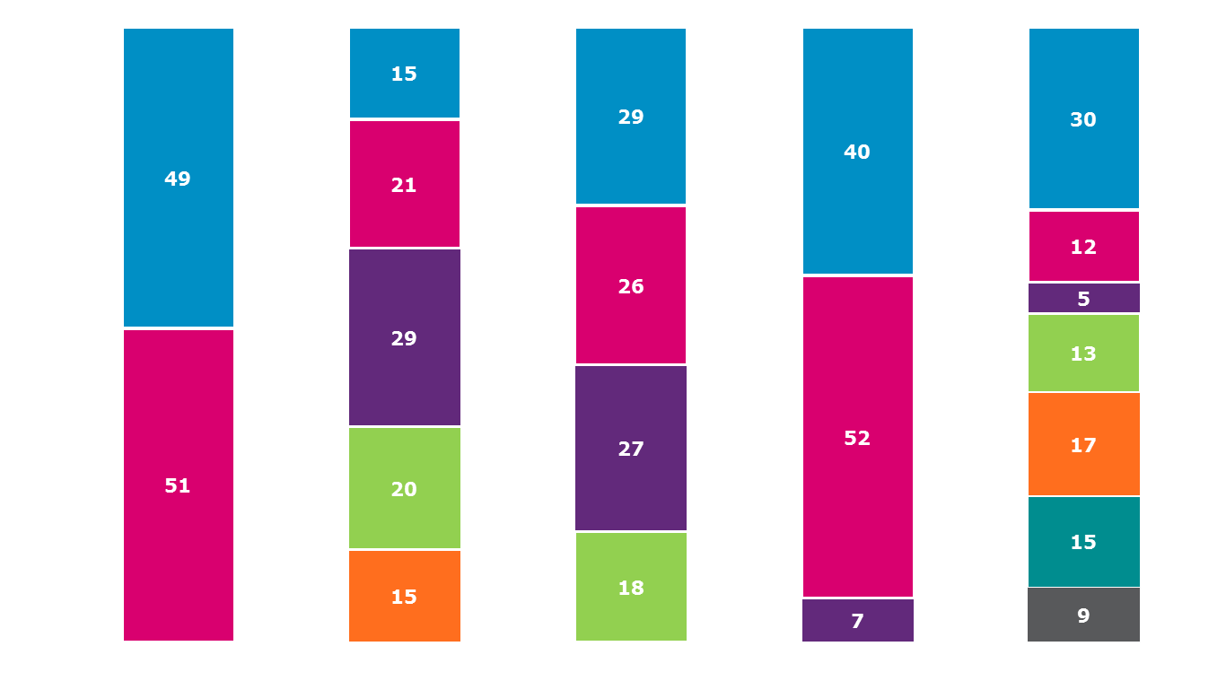
Profile of Sample
Base: All Adults 16+ 1,012
Employment Status
%
Gender
%
Age
%
Region
%
Class
%
16-24
25-34
35-49
50-64
65+
Dublin
Rest of Leinster
Munster
Conn/ Ulster
Working full time
Working part time
Self-employed
Un-employed
Home duties
Retired
Student
ABC1
C2DE
F
Male
Female

Slide 22
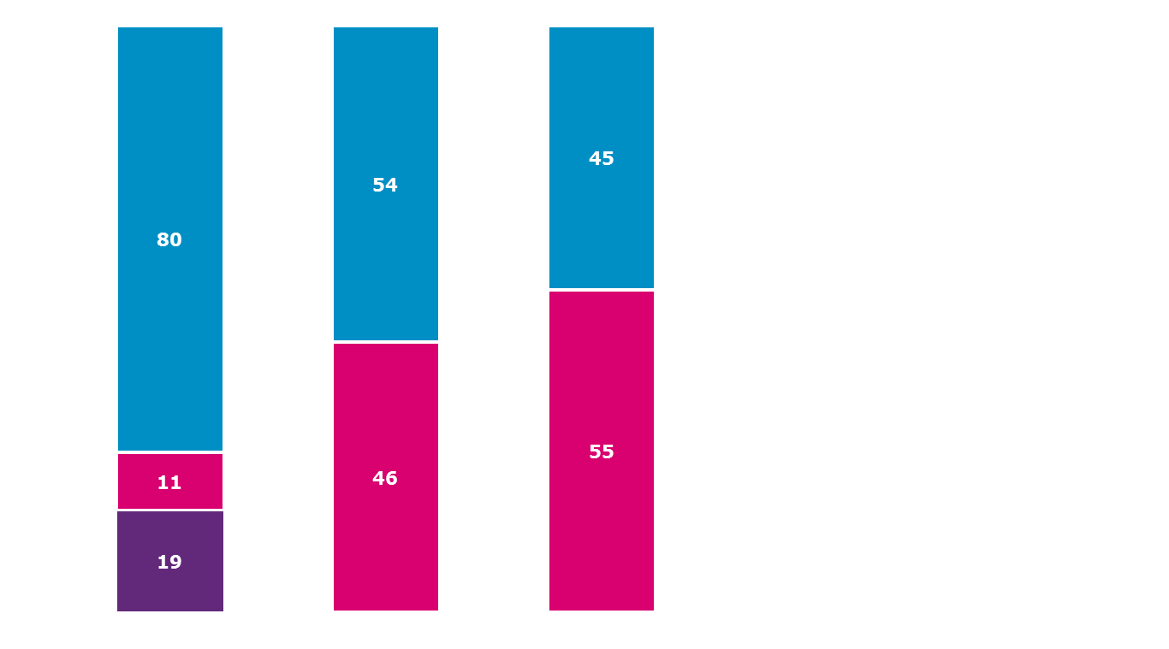
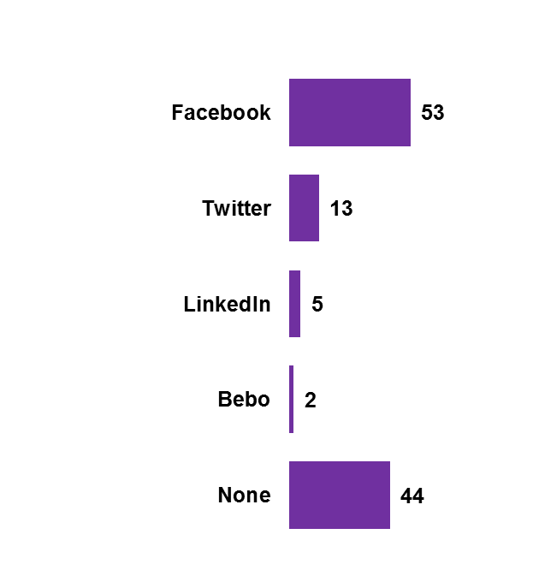
Profile of Sample
Base: All Adults 16+ 1,012
Access the Internet
(All Adults)
%
Bank Online
(All Adults)
%
Purchase Online
(All Adults)
%
Social Media Sites Used
(All who access the internet – 814)
%
Yes
No
Yes
No
Yes – at home
Yes – at work
No access

Slide 23
Incidence of Currently Holding Products or Services
Base: All Adults – 1,012
%

