Slide 1


National Consumer Agency
Market Research Findings:
Consumer Shopping Behaviour
August 2013
Research Conducted by

Slide 2

Table of Contents
Key Findings
Consumer Shopping Behaviour
Research Background and Methodology
Profile of Sample

Slide 3
Key Findings

Slide 4
Key Findings
Over 7 in 10 (72%) women are mainly responsible for the food and grocery shopping in households compared to 1 in 5 (20%) men.
Focus still on price - two thirds (66%) of main grocery shoppers have chosen specific grocery store based on prices or offers.
Shoppers are most definitely wise and thrifty and spread their shopping about. But they do not appear to be inclined to sacrifice quality (81% saying they are not buying products of lower quality).
Majority believe the quality of own-brand products has improved in recent years (71%) and that much of the competition in the grocery sector happens in the own brand segment (57%).
Across all product categories a shift towards own-brand is evident. With the most significant shifts evident in soft drinks, juices, biscuits, and baby products.

Slide 5
Consumer Shopping Behaviour

Slide 6
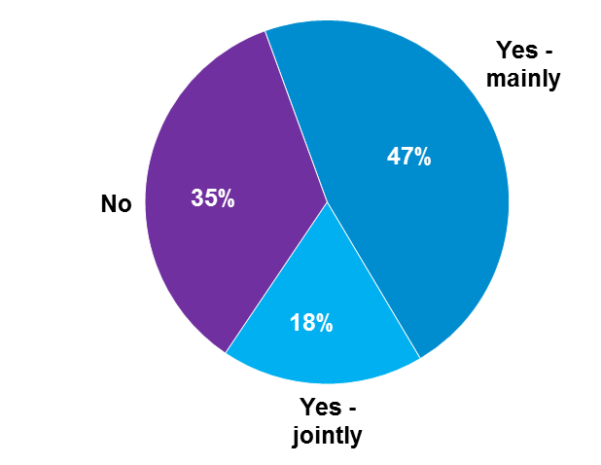
Women continue to be mainly responsible for Food & Grocery Shopping
Base: All Adults 16+ - 1,012
65% have some responsibility for grocery shopping
 | Total | Male | Female | U-24 | 25-34 | 35-49 | 50-64 | 65+ | ABC1 | C2DE | F | Dublin | Leins-ter | Muns-ter | Conn/Uls
Base: | 1,012 | 485 | 527 | 153 | 187 | 288 | 230 | 154 | 436 | 501 | 75 | 291 | 248 | 288 | 185
Yes – mainly | 47 | 20 | 72 | 10 | 45 | 54 | 55 | 59 | 48 | 45 | 47 | 45 | 44 | 47 | 53
Yes – jointly | 18 | 23 | 13 | 12 | 24 | 20 | 18 | 11 | 19 | 18 | 11 | 17 | 19 | 16 | 20
No | 35 | 57 | 15 | 78 | 31 | 26 | 27 | 29 | 32 | 37 | 43 | 38 | 37 | 37 | 27
Women continue to be the main grocery shoppers – 72% of females compared to 20% of males. Those not involved at all tend to be under 25.

Slide 7
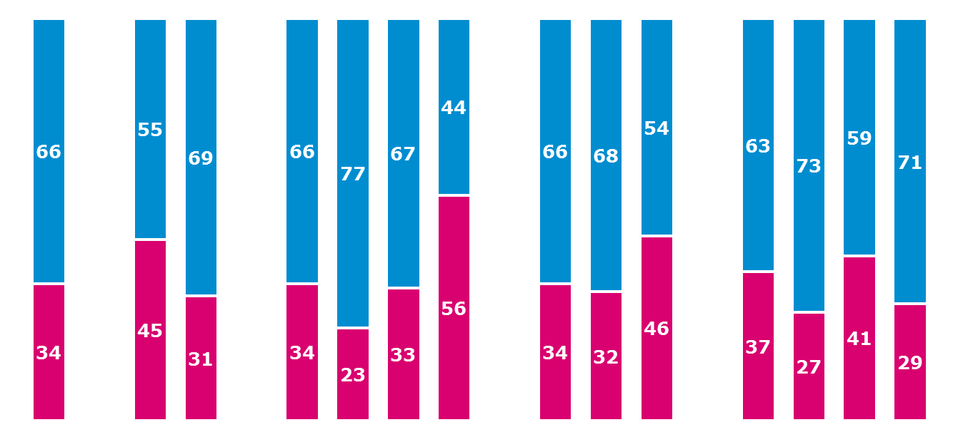
Two thirds of grocery shoppers have made a specific store choice because of Prices or Offers
Base: All Main Grocery Shoppers - 475
Gender
Age
Social Class
Region
Female
%
Lein-ster
%
Mun-ster
%
Conn/Uls
%
Total
%
Male
%
U 35
%
35-49
%
50-64
%
65+
%
ABC1
%
C2DE
%
F*
%
Dublin
%
Yes
No
* Caution low base size
2 in 3 (66%) have made a specific grocery store selection in order to avail of better prices or specific special offers. This is particularly the case in the 35-49 age group with 77% choosing a specific store for this reason.

Slide 8
Shoppers are wise and thrifty, spread their shopping about but are not inclined to give up on quality
Base: All Grocery Shoppers - 646
I am shopping more wisely
%
I have started to shop in a less expensive store
%
I am doing more of my shopping across a range of different stores
%
I am using less processed and ready to eat products
%
I am now buying products of lower quality
%
I am cooking more from scratch
%
Applies
Doesn’t apply at all
Shoppers are very clear about how they shop - they describe themselves as wise, they shop in ‘less expensive’ shops and spread their shopping about but seem less prepared to give up on quality.

Slide 9
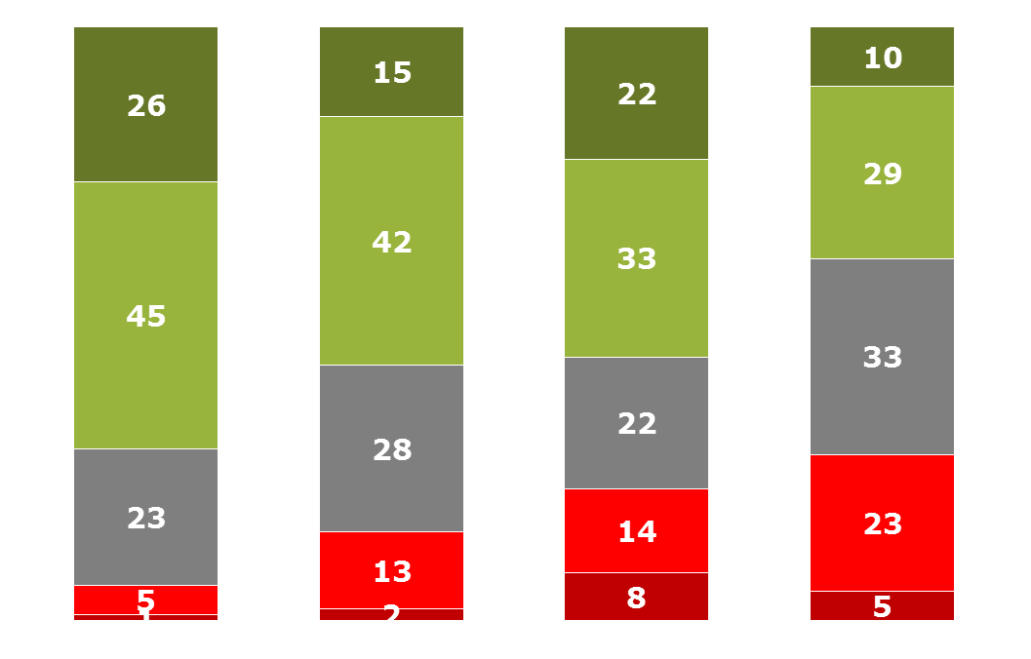
Perceptions of Own-Brand and Branded Shopping
Base: All Main Grocery Shoppers - 475
The quality of own-brand products has improved in recent years | Most competition in the grocery sector happens in the own-brand products | I am now more inclined to purchase own-brand products than I was a year ago | Most competition in the grocery sector happens on branded products
% | % | % | %
Agree strongly (5)
Agree
Neither/nor
Disagree
Disagree strongly (1)
Pos vs Neg | +65 | +42 | +33 | +11
Majority (71%) believe the quality of own-brand products has improved in recent years.
55% are more inclined to purchase own-brand products than they were a year ago.

Slide 10
U35s Most Likely to be conscious of and believe in the quality of Own-Brand
Base: All Main Grocery Shoppers - 475
 | Total | Gender |  | Age |  |  |  | Social Class |  |  | Region
 |  | Male | Female | Under 35 | 35-49 | 50-64 | 65+ | ABC1 | C2DE | F | Dublin | Lein-ster | Mun-ster | Conn/Uls
The quality of own-brand products has improved in recent years | 70 | 53 | 75 | 87 | 80 | 67 | 55 | 71 | 71 | 59 | 73 | 67 | 68 | 74
Most competition in the grocery sector happens on branded products | 57 | 42 | 61 | 69 | 47 | 62 | 55 | 58 | 56 | 56 | 60 | 56 | 52 | 63
I am now more inclined to purchase own-brand products than I was a year ago | 56 | 43 | 59 | 75 | 60 | 51 | 30 | 52 | 62 | 34 | 54 | 56 | 56 | 57
Most competition in the grocery sector happens in the own-brand products | 39 | 38 | 40 | 46 | 33 | 43 | 38 | 38 | 43 | 26 | 43 | 35 | 41 | 38

Slide 11
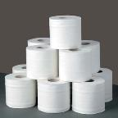
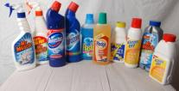


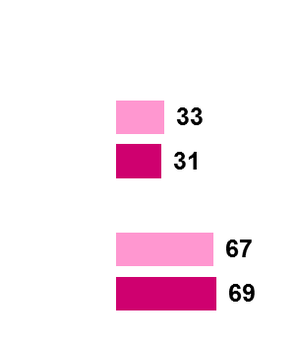
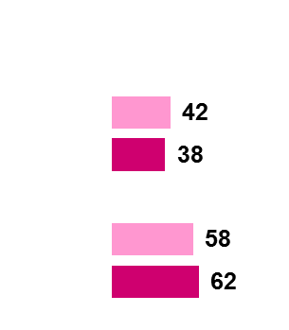
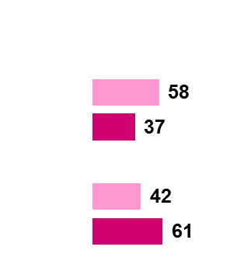
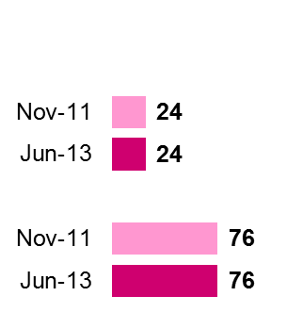
Product Categories where Own-Brand is Strongest
Base: Buyers of each category
Toilet Tissue / Kitchen Roll
Household Cleaning Products
Milk
Juice Drinks
(420)
%
(420)
(415)
%
%
Regular
brand
Own-
brand
%
Toilet paper, household cleaning products, milk and juice drinks are the product categories where own-brand is strongest.

Slide 12



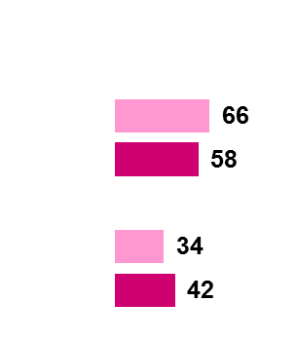


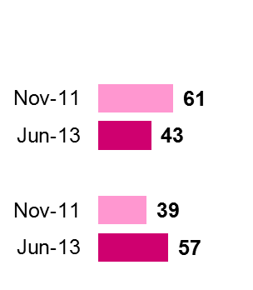
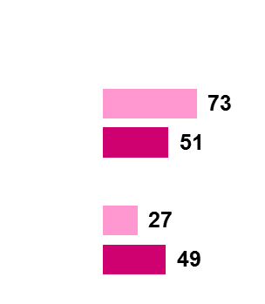
Product Categories where Position is More Evenly Balanced
Base: Buyers of each category
Biscuits
Soft Drinks
Significant growth for own- brand biscuits
and soft drinks.
Regular
brand
Own-
brand
(395)
%
(321)
%
Toiletries
Butter / Spreads
Yoghurts
(420)
%
(417)
%
(371)
%
Regular
brand
Own-
brand

Slide 13




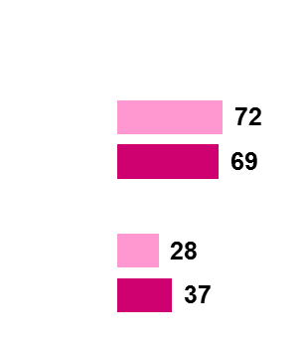
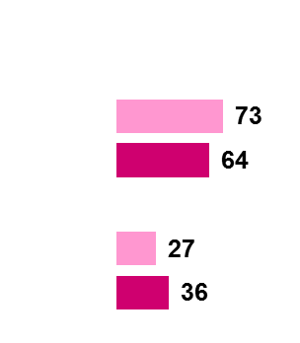

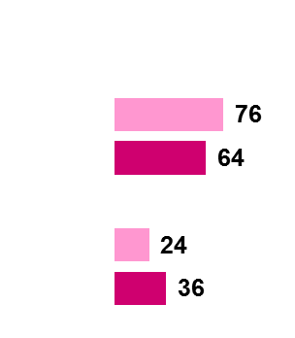
Categories where brands are still Strong - 1
Base: Buyers of each category
Bread
Chocolate / Sweets
Deli/
Processed Meat
Breakfast Cereal
Regular
brand
Own-
brand
(412)
%
(357)
%
(352)
%
(403)
%
A significant movement towards own-brand evident on breakfast cereal.

Slide 14





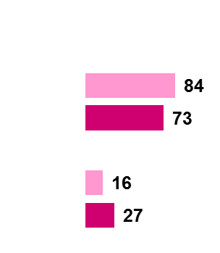
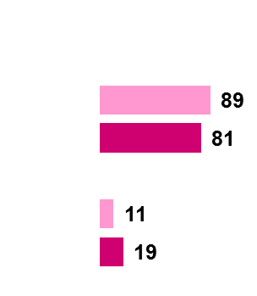


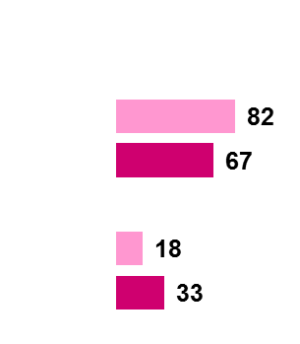
Categories where brands are still Strong – 2
Base: Buyers of each category
Fresh Meat
Frozen Meat
Baby Products
Tea / Coffee
Beer
%
%
%
%
Regular
brand
Own-
brand
(369)
(249)
(95)
(415)
(216)
%
Significant movement towards own-brand is also evident in baby products and tea/coffee.

Slide 15
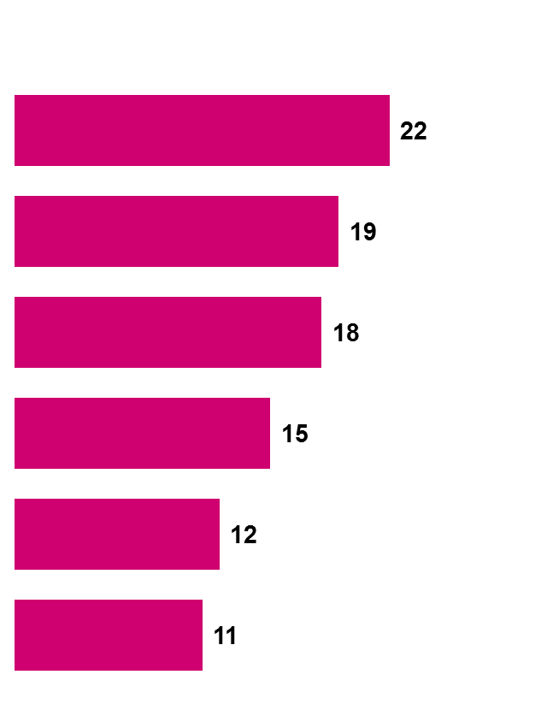
Highlights of the most significant changes in favour of
Own-Brand
In Favour of Brands
%
In Favour of Own-Brand
%
Soft drinks
Juice
Biscuits
Baby products
Breakfast cereal
Tea/coffee
?
No categories show a shift towards buying more branded goods.

Slide 16
Research Background and Methodology

Slide 17
A. Research Background and Methodology
Nov/Dec 2007
Aug 2008
Nov/Dec 2008
May/June 2009
Benchmark
Wave 1
Wave 2
Wave 3
Nov/Dec 2009
June 2010
Nov/Dec 2010
May/June 2011
Wave 4
Wave 5
Wave 6
Wave 7
Nov 2011
June 2012
Nov 2012
June 2013
Wave 8
Wave 9
Wave 10
Wave 11
The research was conducted face-to-face using CAPI interviewing with 1,012 adults 16+.
To ensure that the data is nationally representative, quotas were applied on the basis of age, gender and social class.
Interviewing was conducted from 6th – 19th June 2013.

Slide 18
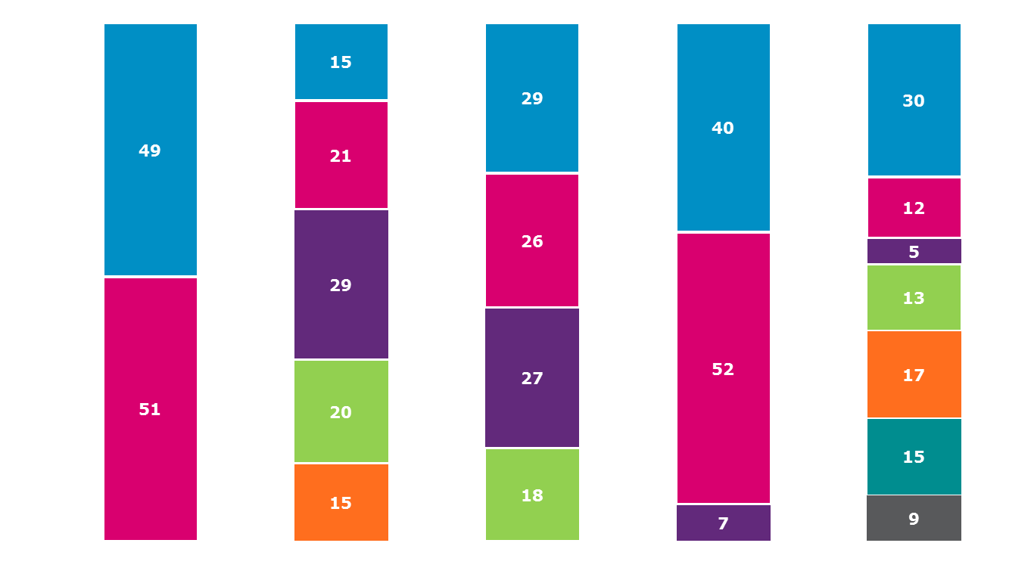
Profile of Sample
Base: All Adults 16+ 1,012
Employment Status
%
Gender
%
Age
%
Region
%
Class
%
16-24
25-34
35-49
50-64
65+
Dublin
Rest of Leinster
Munster
Conn/ Ulster
Working full time
Working part time
Self-employed
Un-employed
Home duties
Retired
Student
ABC1
C2DE
F
Male
Female

Slide 19
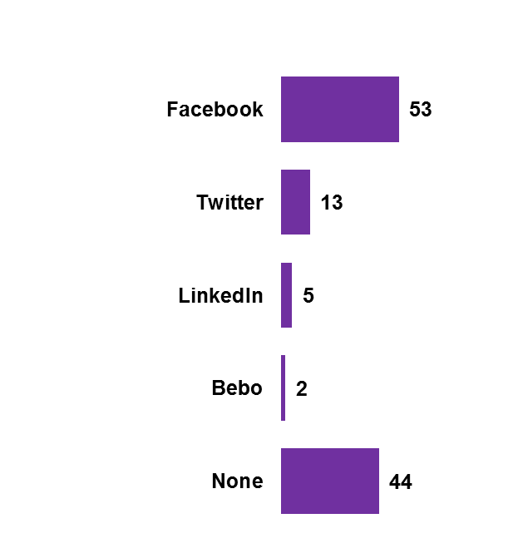
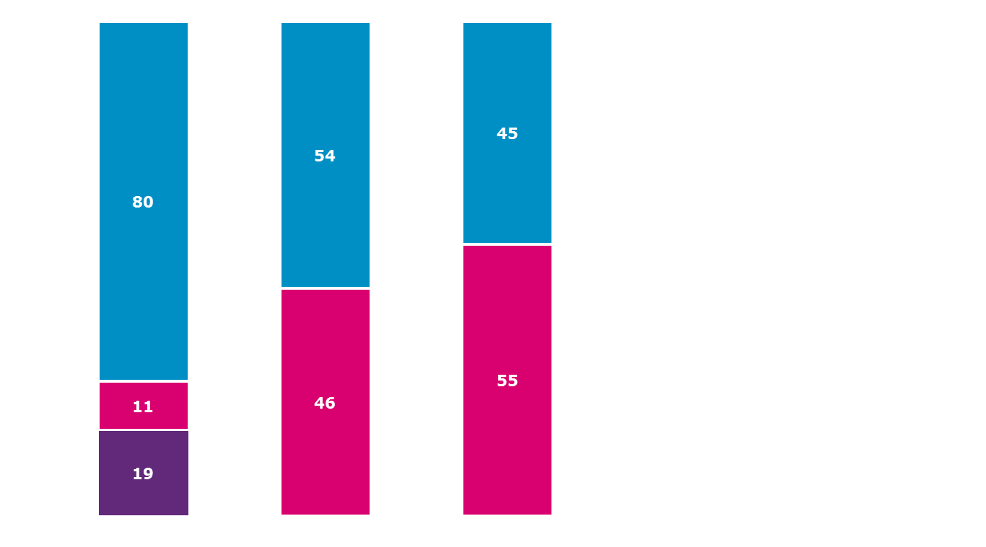
Profile of Sample
Base: All Adults 16+ 1,012
Access the Internet
(All Adults)
%
Bank Online
(All Adults)
%
Purchase Online
(All Adults)
%
Social Media Sites Used
(All who access the internet – 814)
%
Yes
No
Yes
No
Yes – at home
Yes – at work
No access

