Slide 1
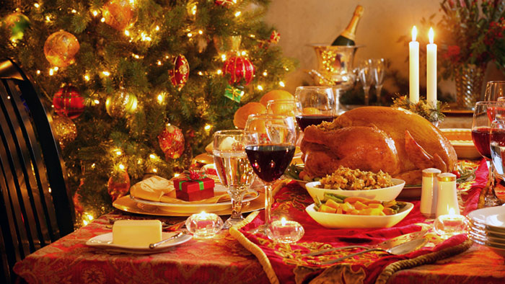
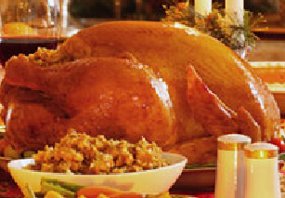
ROI GROCERY MARKET REVIEW
Data to 5th January 2014

Slide 2

OVERVIEW
Market Overview
The market is seeing positive growth on an annual basis of +0.8% but the latest quarter has been more difficult with a -0.2% decline.
While there has been price inflation, shoppers continue to compensate for price increases by purchasing on offer and trading down to cheaper lines. However increased volume bought over the Christmas period together with price inflation has resulted in year on year household spend increasing by +0.7%.
Irish households are making more trips this period, with frequency up by +0.8%.
Spend per trip has remained steady, spend per household has increased.
Although the private label share of the grocery market slowed during the lead up to the Christmas period, it is still well ahead of last year.

Slide 3
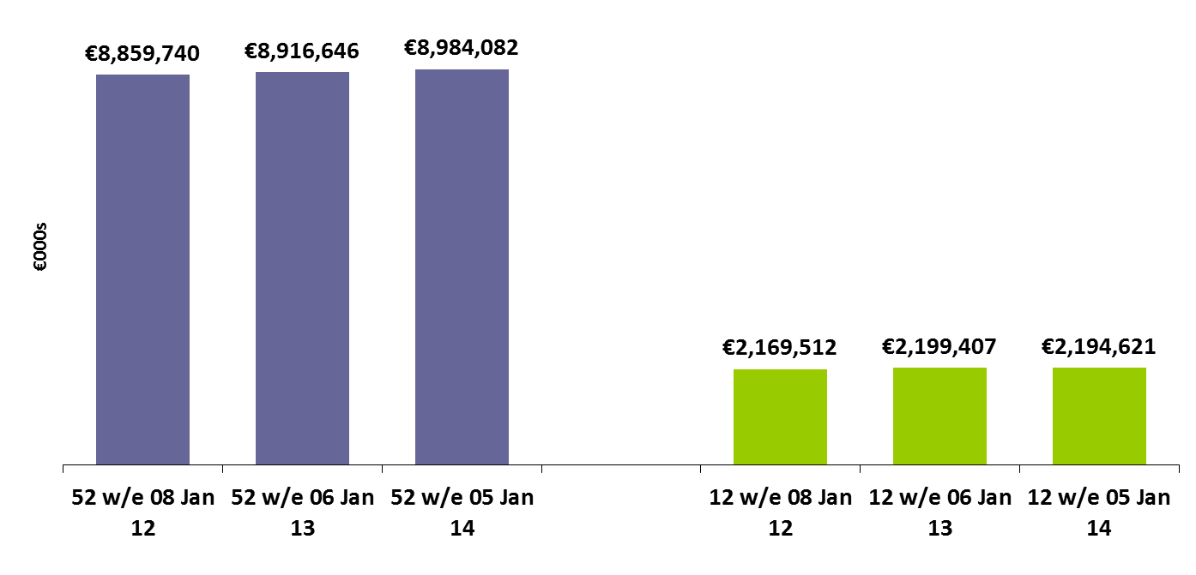
Total Irish Grocery Market Value and Growth - 52 and 12 w/e
Irish grocery market sales have grown over the 52 week period by 0.8%, but are down by 0.2% for the 12 week period
+0.6%
+0.8%
+1.4%
-0.2%
3

Slide 4
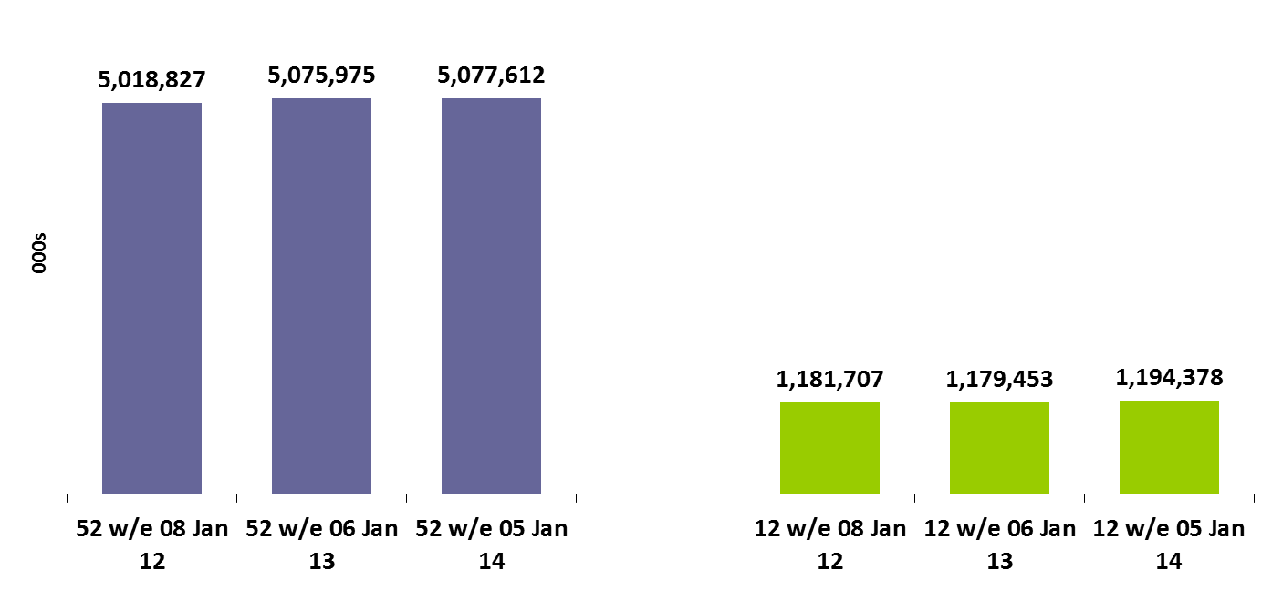
Total Irish Grocery Market Volume Sales and Growth - 52 and 12 w/e
Growth of 1.3% in volume sales in the 12 week period Volume sales flat over the 52 week period
+1.1%
0.0%
-0.2%
+1.3%
4

Slide 5
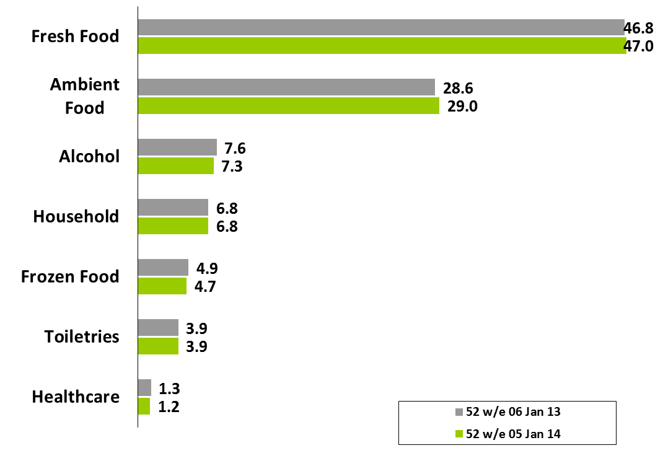
Total Grocery - Sector Value Share & Growth 52w/e
Fresh Food, Ambient Food and Toiletries driving growth in Grocery over the full year
+1.3%
+1.9%
-3.3%
+0.7%
-3.1%
+1.4%
-7%

Slide 6
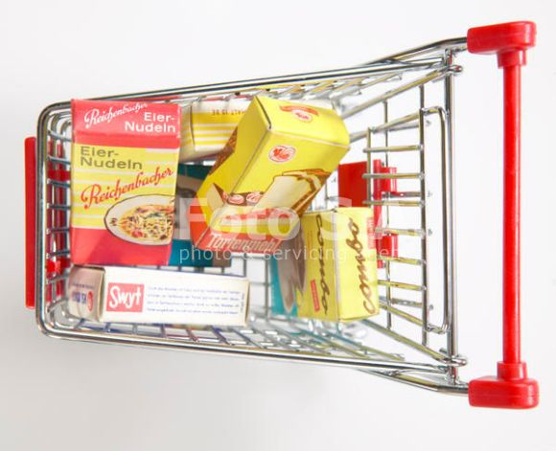
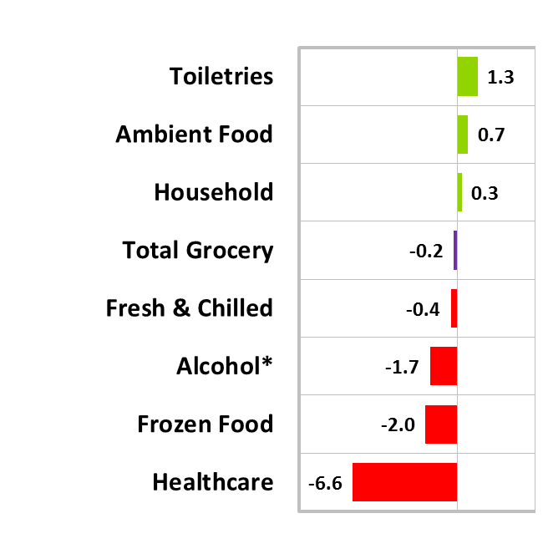
Total Grocery - Sector Value Share & Growth 12w/e
The decline in 12 week sales is coming from sales losses year on year in Healthcare, Frozen Food, Alcohol and Fresh & Chilled Food
Share of total trolley
Ambient Food
30%
Fresh & Chilled Produce
47%
Household 7%
Frozen 5%
Toiletries 4%
Healthcare 1%
Alcohol 7%
Total Trolley
-0.2% value
6

Slide 7
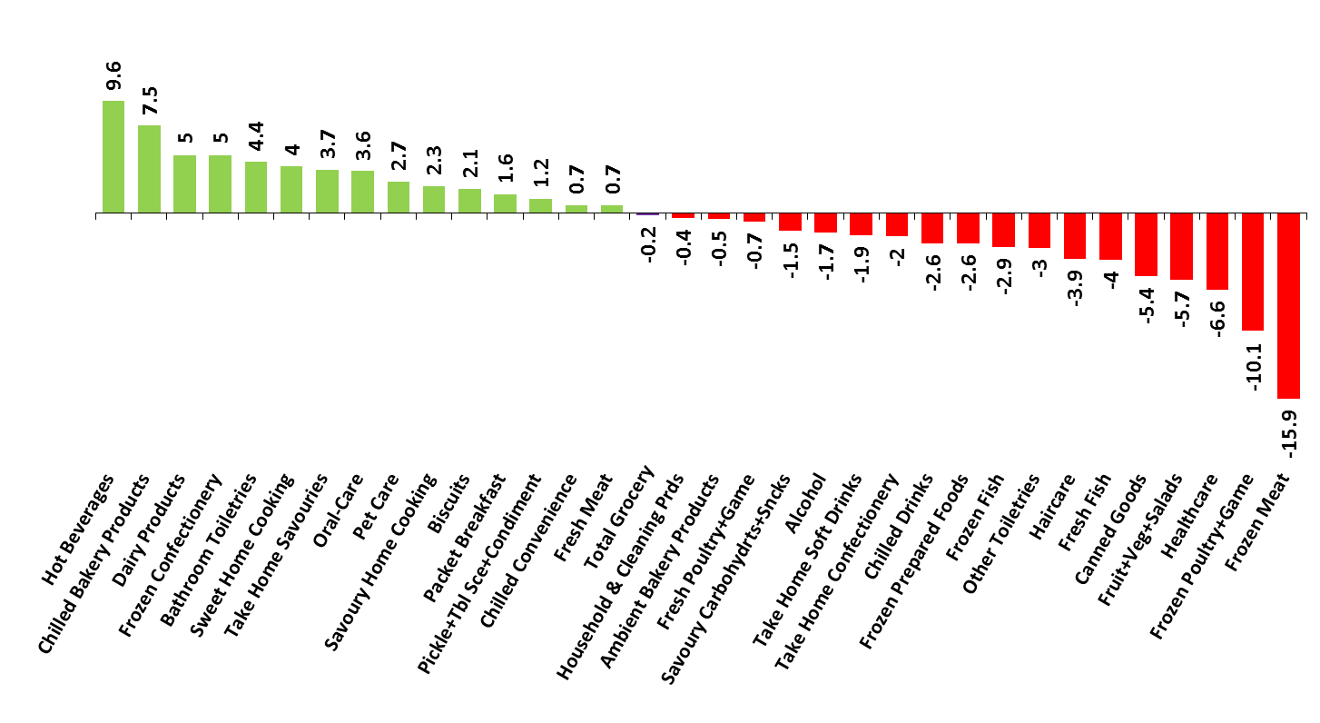
Analysis by Category – Growth/Decline?
Decline in Frozen Meat, Frozen Poultry & Game, Healthcare and Fruit & Veg & Salad
12w Total Grocery - value % change by category
7

Slide 8
Large Majority of Markets Seeing Price Inflation, in particular Toiletries and Alcohol

Slide 9
Change in Inflation Rates and Household Spend 12 w/e
Inflation for the Irish grocery market is just under 3%
% change year on year – 12 week period
9

Slide 10

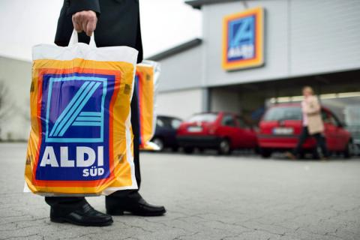

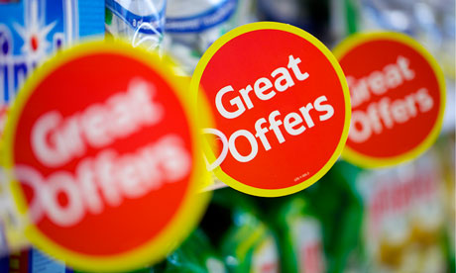
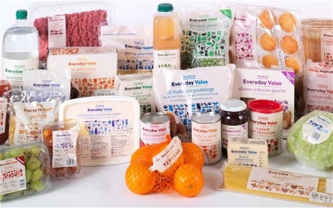
How are shoppers coping?
Store choice
Spend less
Buy on deal
Trade down

Slide 11
Trended View of Consumer Coping Strategies
Trading down product or price tier still remains the key method of dealing with inflation while shoppers are back to buying more volume
11

Slide 12
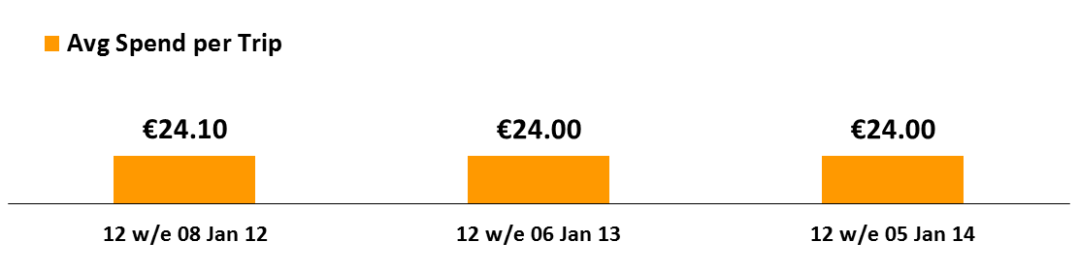
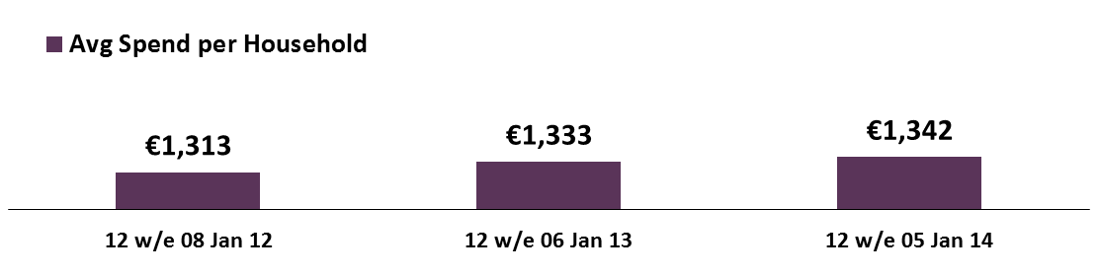
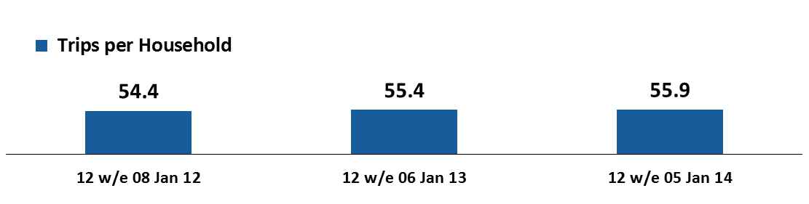
Changes in Consumer Shopping Behaviour - 12w/e
Shoppers are buying more often with frequency increasing by +0.8%. While spend per trip has remained steady, spend per Household has increased by €9.
Average frequency increased by
+0.8%
Increase in 12w spend per HH
(+0.7%)
Average basket spend is at
-0.1%
12

Slide 13
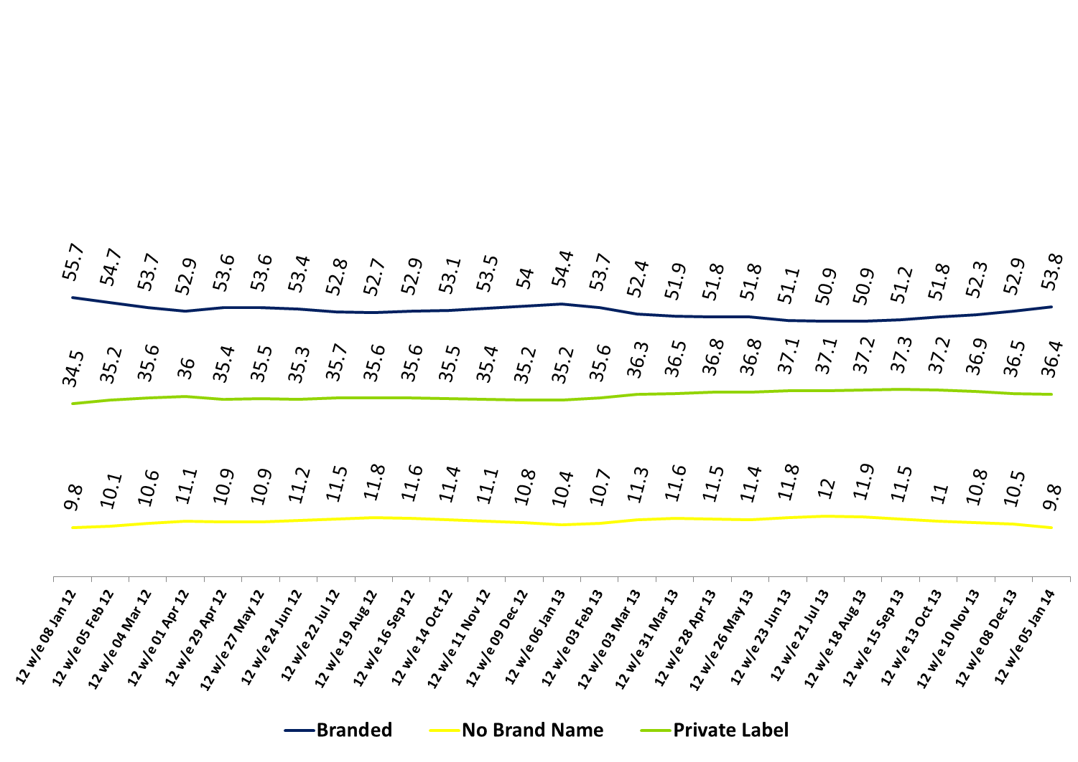
Share of Market - Branded, Private Label and No Brand Name
While Branded share had seen some share growth in the run up to Christmas, branded sales are down compared to last year.
12w Total Grocery – value %
13

Slide 14
Private Label Value Share of Total Irish Grocery Market
Private Label share of the grocery market slowed as we moved towards Christmas however still performed well ahead of last year
12w Total Grocery – Private Label value %
14

Slide 15
Branded and Private Label Inflation – 12w/e
Inflation in Private Label goods beginning to drop back

Slide 16
Private Label % Value Share by Category
Where is Private Label Strong? – Meats and staples are key for Private Label
12w Total Grocery - Categories where Private Label overtrade
16

Slide 17
Private Label % Value Share by Category
Where is Private Label weaker? – Categories with multiple strong brands and toiletries perform well
12w Total Grocery - Categories where Private Label undertrade
17

Slide 18
Market Share and Growth by Branded and Private Label Tier
Premium Private Label in growth while Value Private Label declines with shoppers most likely to trade up around Christmas
% Value Share
% Value Growth

Slide 19
Average price per pack (€)
€3.09
Premium PL
Shoppers trading up to Premium Private Label this period while Standard Private Label still gains from Branded
€1.5m
€2.61
Branded
€203k
€4.8m
€1.75
€503k
Standard PL
€1.05
Value PL

Slide 20
Total Grocery – % Packs Sold On Deal – 52 w/e
Shoppers perceive that the % of packs sold on deal is consistent over time

Slide 21
Total Grocery - Sold on Deal Trended 12 w/e
Promotional activity still hovers around the 14% mark of grocery sales however promotional activity is higher than this time last year

Slide 22
Total Grocery - Sector Share Sold on Promotion – % Packs
Promotional activity on Alcohol is behind what we saw last year

Slide 23
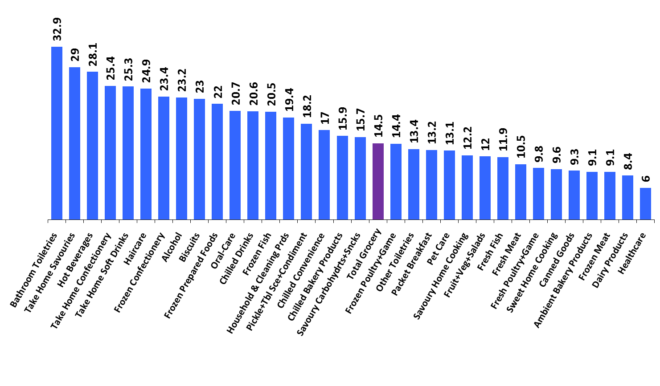
Bathroom Toiletries & Take Home Savouries Have the Highest % of Packs Sold On Deal, While Healthcare and Dairy Products Have the Lowest Percentages.
12w Total Grocery - pack % sold on deal by category
23

Slide 24


Cross Border Grocery Trade Update
Notes:
Finally then in terms of the reatailers, well have a look at cross border shopping and what hapend with uk trade this year

Slide 25
Total Cross Border Sales – Share of ROI Grocery Market – 52 w/e
Cross Border Sales continue to decline now making up just under 2% of sales (€173m) down 6% on last year.

Slide 26
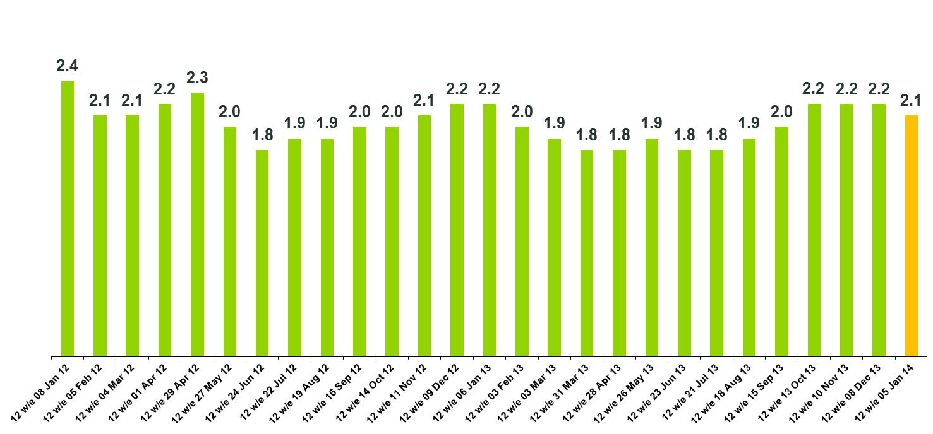
Total Cross Border Sales – Share of Irish Grocery Market – 12 w/e
Cross border share declined over Christmas despite seeing an increase over the pervious periods.
Cross Border Value % Share of ROI Grocery Market – 12w/e
26

Slide 27
Total Cross Border - % Penetration
16% of ROI shoppers have shopped across the border in the last 12 weeks

Slide 28
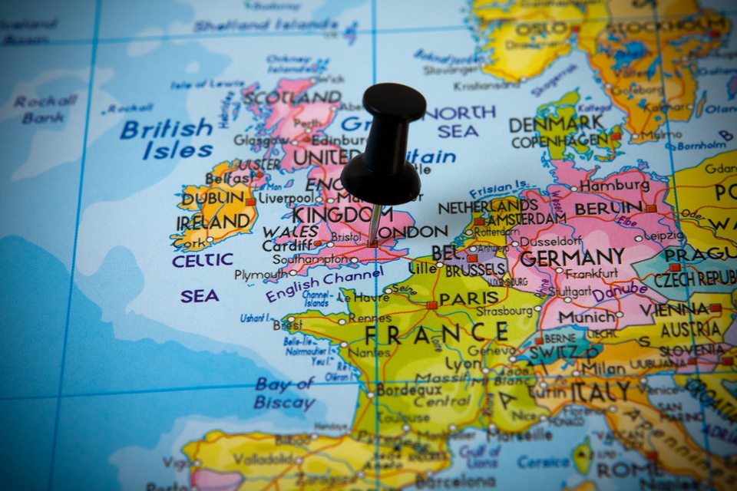
UK GROCERY

Slide 29
UK Grocery – Value Sales
UK market showing growth year on year as inflation plays a part
52w/e UK Grocery Value sales
+3.6%

Slide 30
UK Market Growth and Inflation

Slide 31
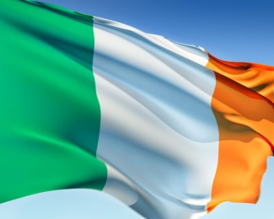
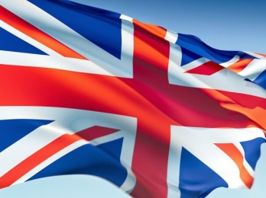
How do GB & Ireland grocery markets compare?
Market Size
Grocery Spend per HH
Market Growth
Price Inflation
€9b
€5,500
0.8%
2.9%
£104b
stg£3,900
+3.7%
+2.5%
Source: Kantar Worldpanel, data to 5th Jan 2014

Slide 32
Private Label % Market Share
Private label rising in the UK up to 47.9%

