Slide 1




ROI GROCERY MARKET REVIEW
Data to 15th September 2013

Slide 2

OVERVIEW
Market Overview
The market is seeing positive growth on an annual basis and in the shorter term by +1.2%.
While there has been price inflation, shoppers continue to compensate for price increases by purchasing on offer and trading down to cheaper lines. In spite of this household spend has increased year on year by +2.1%.
Irish households are spending slightly more per trip this period, and more per year, however they are making less trips.
Shoppers continue to shop around.
Private label continues to be important as a method of reducing spend with a market share at 37.3%.

Slide 3
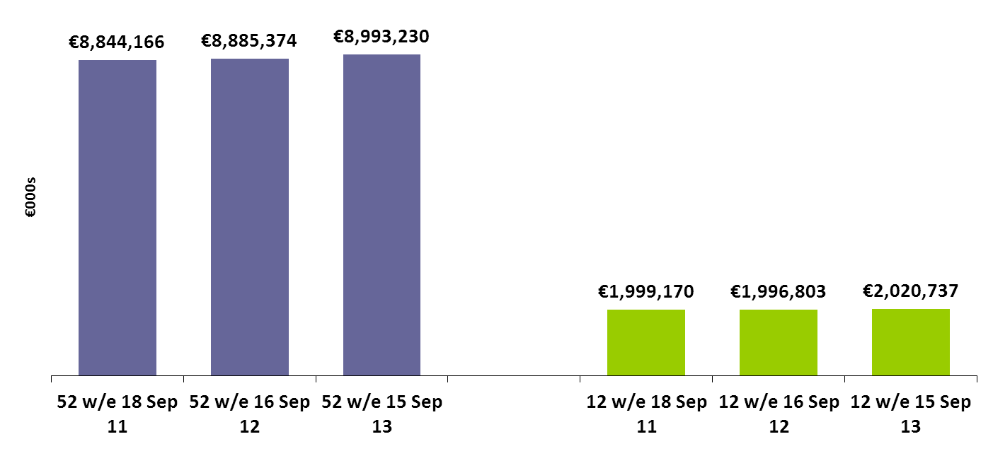
TOTAL IRISH GROCERY MARKET VALUE AND GROWTH 52 &12 W/E
Irish grocery market sales have grown over 52we and 12we by +1.2%.
+0.5%
+1.2%
-0.1%
+1.2%
3

Slide 4
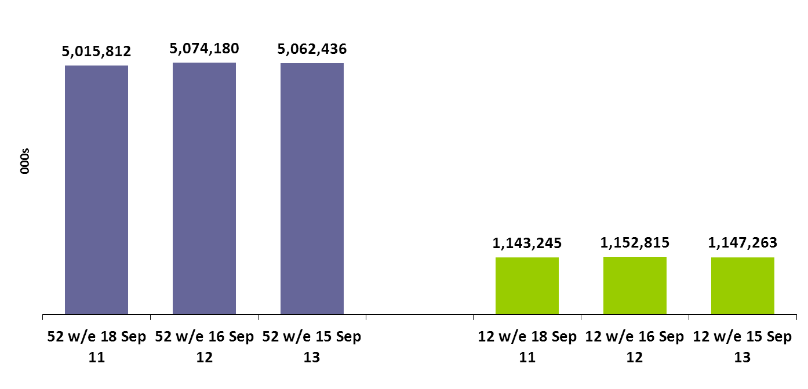
TOTAL IRISH GROCERY VOLUME SALES AND GROWTH 52 &12 W/E
Volume of sales falling slightly in both 52 and 12 we.
+1.2%
-0.2%
+0.8%
-0.5%
4

Slide 5
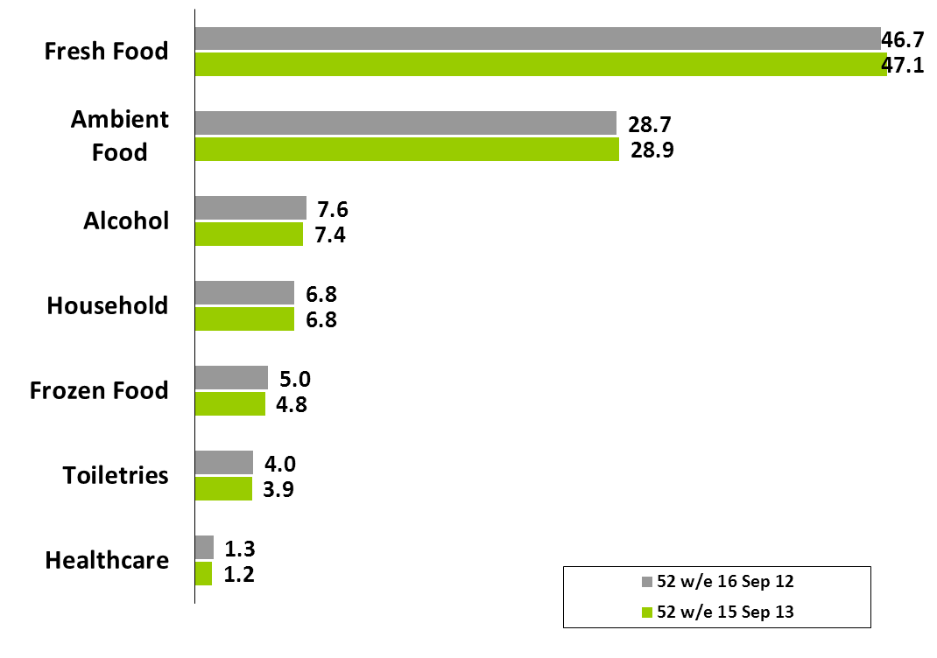
TOTAL GROCERY SECTOR VALUE SHARE & GROWTH 52W/E
Fresh Food and Ambient Food is driving growth in Grocery.
+2.1%
+1.8%
-1.3%
+0.7%
-3%
-0.3%
-4.4%

Slide 6
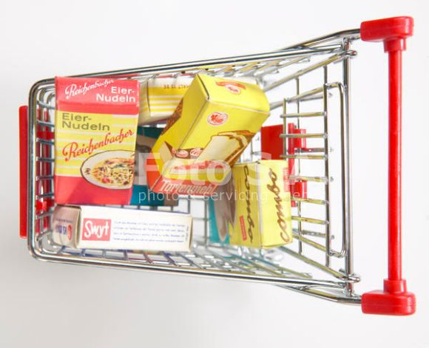
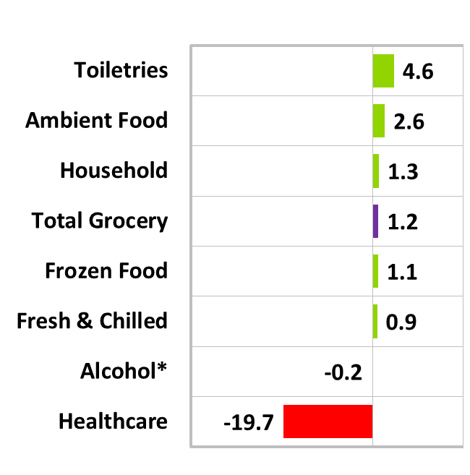
TOTAL GROCERY SECTOR VALUE SHARE & GROWTH 12W/E
Grocery Market’s growth has been driven by the performance of Toiletries and Ambient Food.
Share of total trolley
Ambient Food
28%
Fresh & Chilled Produce
48%
Household 7%
Frozen 5%
Toiletries 4%
Healthcare 1%
Alcohol 7%
Total Trolley
+1.2% value
6

Slide 7
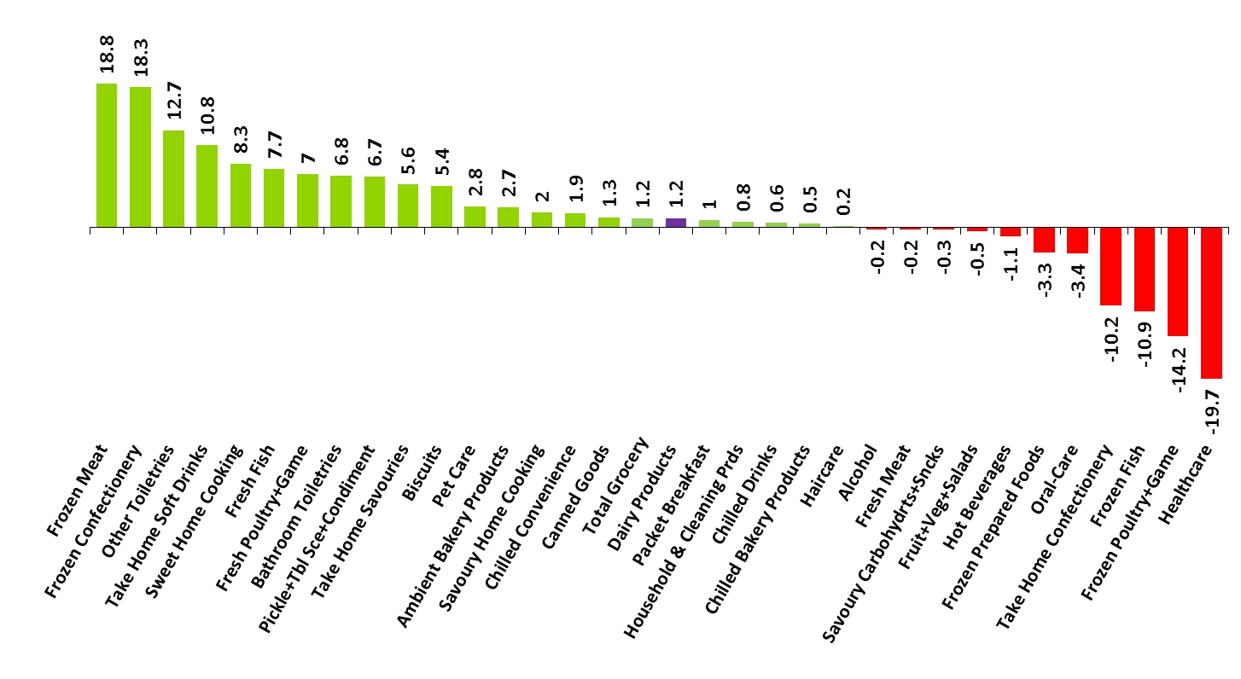
ANALYSIS BY CATEGORY – GROWTH/DECLINE?
Frozen Meat and Confectionary have grown, on the back of decline for Healthcare and Frozen Poultry and Fish.
12w Total Grocery - value % change by category
7

Slide 8
Large majority of markets seeing price inflation, in particular Toiletries and Alcohol

Slide 9
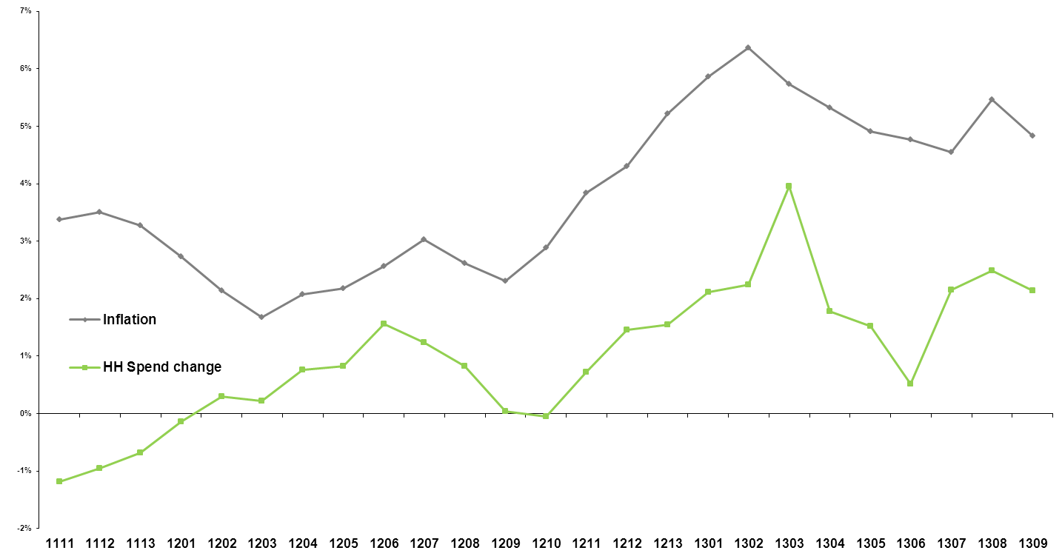
CHANGE IN INFLATION RATES AND HOUSEDHOLD SPEND 12 W/E
Household Spend has increased by +2.1% year on year as households fight inflation increases.
% change year on year – 12 week period
9

Slide 10
Food accounting for less of overall Household Expenditure
CSO – Household Budget Survey 2009-2010 Volume 2
Notes:
When looking at the overall Household expenditure there has been a big shift in the importance of Food. In the 1980s Food accounted for 30% of household expenditure however in the latest figures from the CSO Household Budget Survey this has fallen to 16%. As people find themselves being hit in their wallets Food is one of the biggest areas where they look to manage spend.

Slide 11
TRENDED VIEW OF CONSUMER COPING STRATEGIES – 12 W/E
Shoppers are dealing with inflation by buying on promotion and switching stores.
11

Slide 12
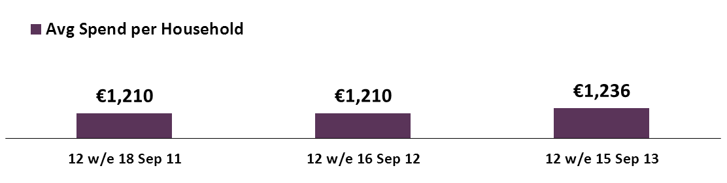
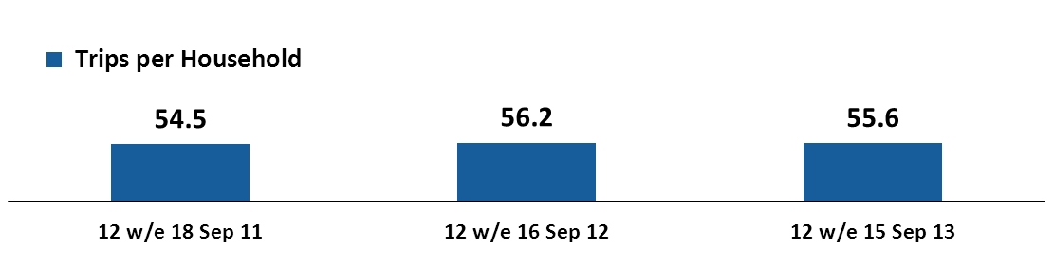
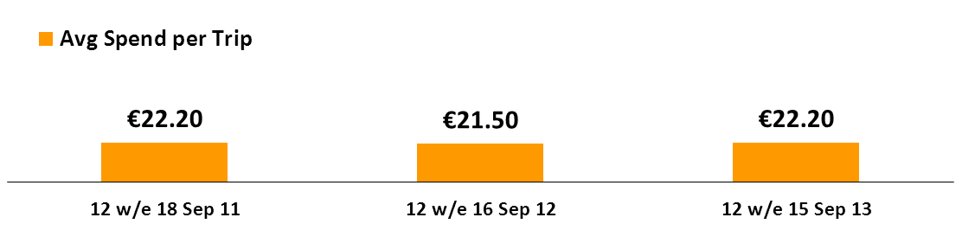
CHANGES IN CONSUMER SHOPPING BEHAVIOUR 12W/E
Frequency has decreased by -1.1%, with shoppers spending more per trip. This has led to an increase in spend per Household of €26.
12w Total Grocery - changes in consumer shopping behaviour
Average frequency decreased by
-1.1%
Increase in 12w spend per HH
(+2.1%)
Average basket spend is up by
+3.2%
12

Slide 13
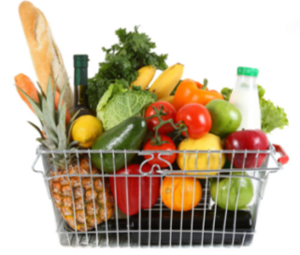


Shopper are buying less categories over time
Average number of categories bought by shoppers in a given year
2011
157
Categories
seeing volume decline
126
2012
125
2013
124
Notes:
In 2011 the average number of categories bought is 126 in 2012 this dropped to 125 and 124 in 2013. This in and of itself might seem like a big change but when you look beneath this and consider the fact that 157 of the 280 categories we capture are seeing a volume decline, it puts the market into perspective.

Slide 14
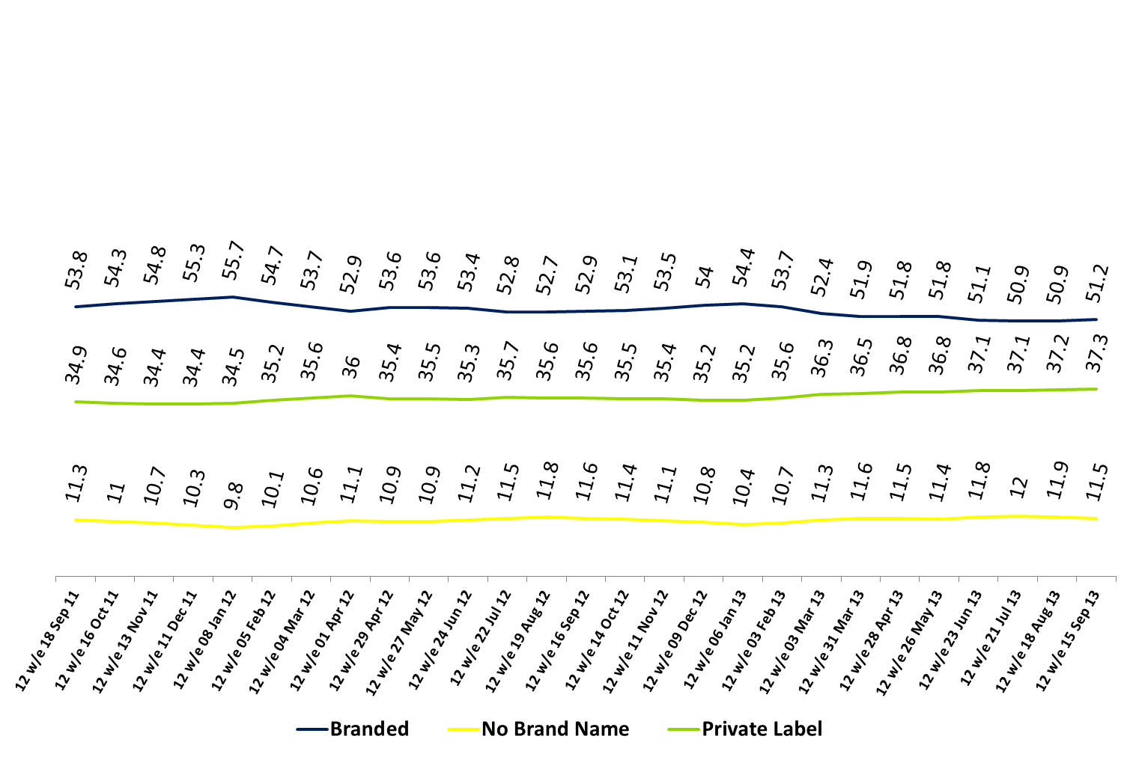
SHARE OF MARKET – BRANDED, PRIVATE LABEL AND NO BRAND NAME
Branded share have seen some growth as Private Label remains steady.
12w Total Grocery – PL value%
14

Slide 15
PRIVATE LABEL VALUE SHARE OF TOTAL IRISH GROCERY
Private Label remains steady at 36.7%
12w Total Grocery – PL value%
15

Slide 16
PRIVATE LABEL % VALUE SHARE BY CATEGORY
Where is Private Label Strong? – Meats and staples are key for Private Label
12w Total Grocery - Categories where Private LABEL overtrade
16

Slide 17
PRIVATE LABEL % VALUE SHARE BY CATEGORY
Where is Private Label weaker? – Categories with multiple strong brands and toiletries perform well
12w Total Grocery – Categories where Private Label undertrade
17

Slide 18
MARKET SHARE AND GROWTH BY BRANDED AND PRIVATE LABEL TIER
Standard Private Label in growth this period while Premium Private Label declines
% Value share
% Value growth

Slide 19
Average price per pack (€)
€2.97
Premium PL
Shoppers move from branded to Private Label, and trade down from Premium Private Label to standard, each time spending less
€874k
€2.46
Branded
€1.1m
€1.7m
€1.71
€796k
Standard PL
€1.6m
€1.10
Value PL

Slide 20
TOTAL GROCERY – % PACKS SOLD ON DEAL – 52W/E
Shoppers perceive the %packs sold on deal is consistent over time

Slide 21
TOTAL GROCERCY - SOLD ON DEAL TRENDED 12W/E
Not much change in the proportion of sales on deal with more consistent promotional activity across retailers

Slide 22
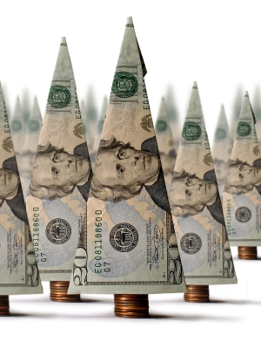

% of branded grocery spend accounted for by round € or 50c price points
Pricing clarity continues to cut through with shoppers

Slide 23
Total Grocery Sector Share of Promotion – % Packs
52we, Alcohol has a higher share of promotion than any other sector but drops compared to the same time last year. Promotion on Frozen increases to try and encourage shoppers to the sector.

Slide 24
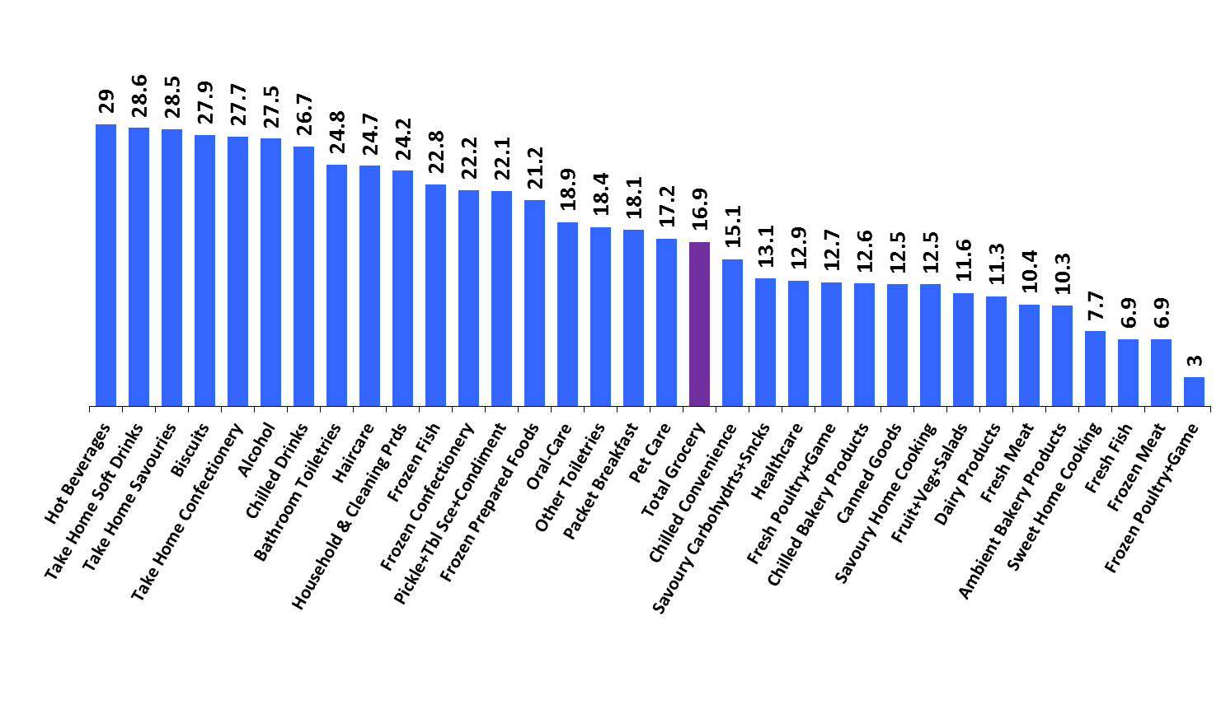
Hot Beverages have the highest proportion of packs sold on deal.
12w Total Grocery - pack % sold on deal by category
24

Slide 25
Total Cross Border – Share of ROI Grocery
Cross Border Sales continue to decline now making up 2% of Sales (€176m)

Slide 26
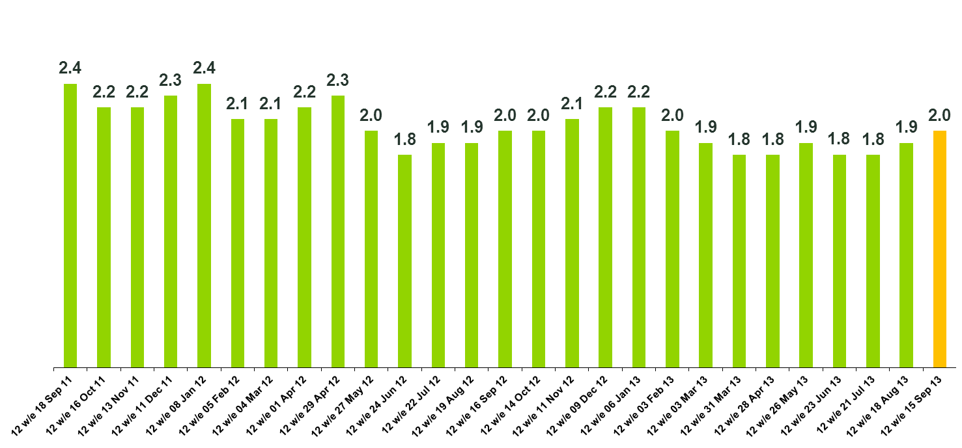
12w Total Grocery – Total Cross Border value% of ROI grocery
Cross border share of sales grown to 2% in the latest period. 42% of this spend is from Connaught and Ulster
26

Slide 27
TOTAL CROSS BORDER - % PENETRATION
15% of ROI shoppers have shopped across the border in the last 12 weeks

Slide 28
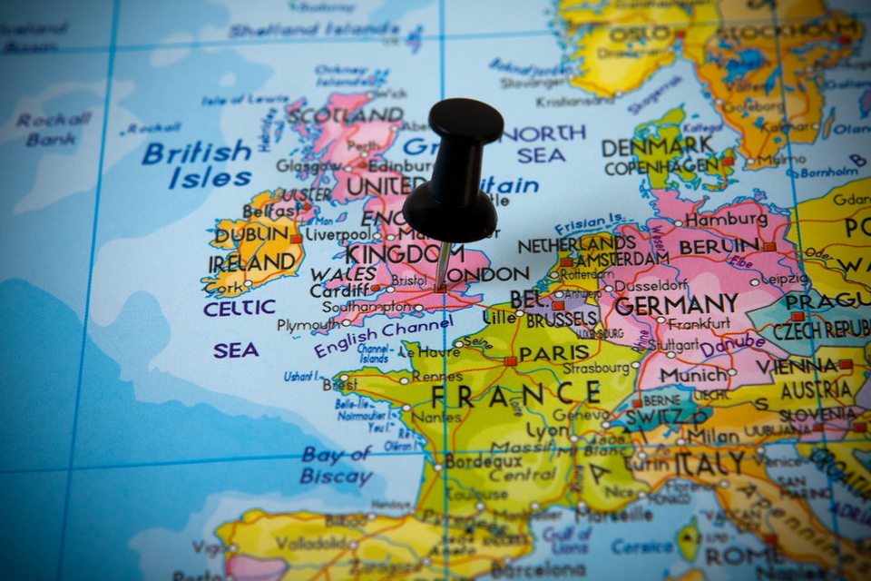
UK GROCERY

Slide 29
TOTAL UK GROCERY - VALUE SALES
UK market showing growth year on year as inflation plays a part
52w/e
+3.9%

Slide 30
UK MARKET GROWTH AND INFLATION
Inflation in the UK slightly behind Ireland but market growth is stronger

Slide 31
CONSUMER TRENDS
Trading down product and store
Ireland PL
GB PL
+4%
+10%
Promotion/ Product Change
+8.3%
Store Choice
“I am on a strict budget when I go shopping in the Republic of Ireland”
Inflation
Volume per buyer
GB
Ireland
Aug 11
Aug 12
Aug 13
KANTAR WORLDPANEL 12 WE DATA TO 18th AUGUST 2013

Slide 32
PRIVATE LABEL % MARKET SHARE
Private label has taken a slight dip in the UK

